Slide 1
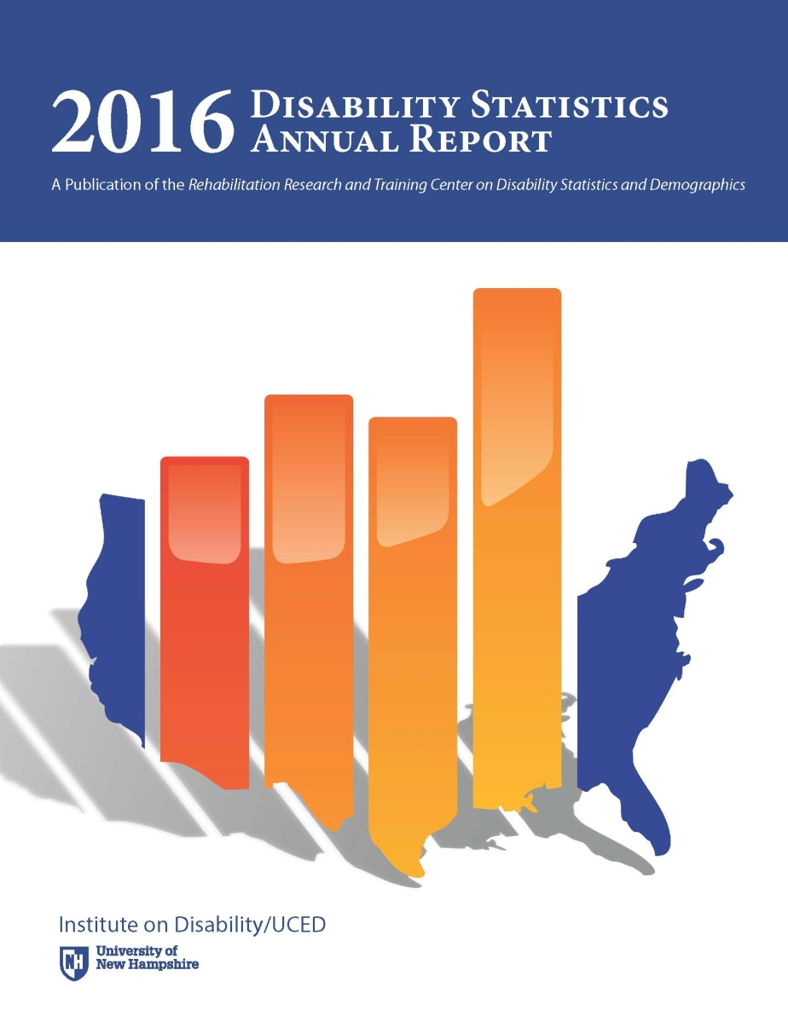
Annual Report on Disability Statistics
Lewis Kraus
Center on Disability at the Public Health Institute
1

Slide 2
2016 Annual Report on Disability Statistics
Addresses
How many people with disabilities live in the United States?
What is the percentage of people with disabilities in different age groups?
What is the percentage of people with disabilities for different types of disability?
To what extent are people with disabilities employed?
What are the earnings for people with and without disabilities?
What is the poverty percentage for people with and without disabilities?
Is disability status associated with percentages of smoking, obesity, and binge drinking?
Highlights state and trend data from national sources
2
Notes:
The Annual Report presents statistics from national data sources to address the following types of questions:
• How many people with disabilities live in the United States?
• What is the percentage of people with disabilities in different age groups?
• What is the percentage of people with disabilities for different types of disability?
• To what extent are people with disabilities employed?
• What are the earnings for people with and without disabilities?
• What is the poverty percentage for people with and without disabilities?
• Is disability status associated with percentages of smoking, obesity, and binge drinking?
The Annual Report highlights state and trend data from national sources
The Annual Report charts complement the detailed tables of data which can be found in the 2016 Annual Disability Statistics Compendium

Slide 3
2016 Annual Report on Disability Statistics
Same format as 2014 and 2015 Annual Reports
Highlights
State data
Trend data
Differences by age ranges
Gaps
3
Notes:
The 2016 Annual Report follows the same format as the 2014 and 2015 Annual Reports on Disability, highlighting state data and the variability in disability rates by state. Additionally, this Annual Report highlights trend data across several years, shows differences by age ranges, and new this year, emphasizes gap percentages between data concerning people with and without disabilities.

Slide 4
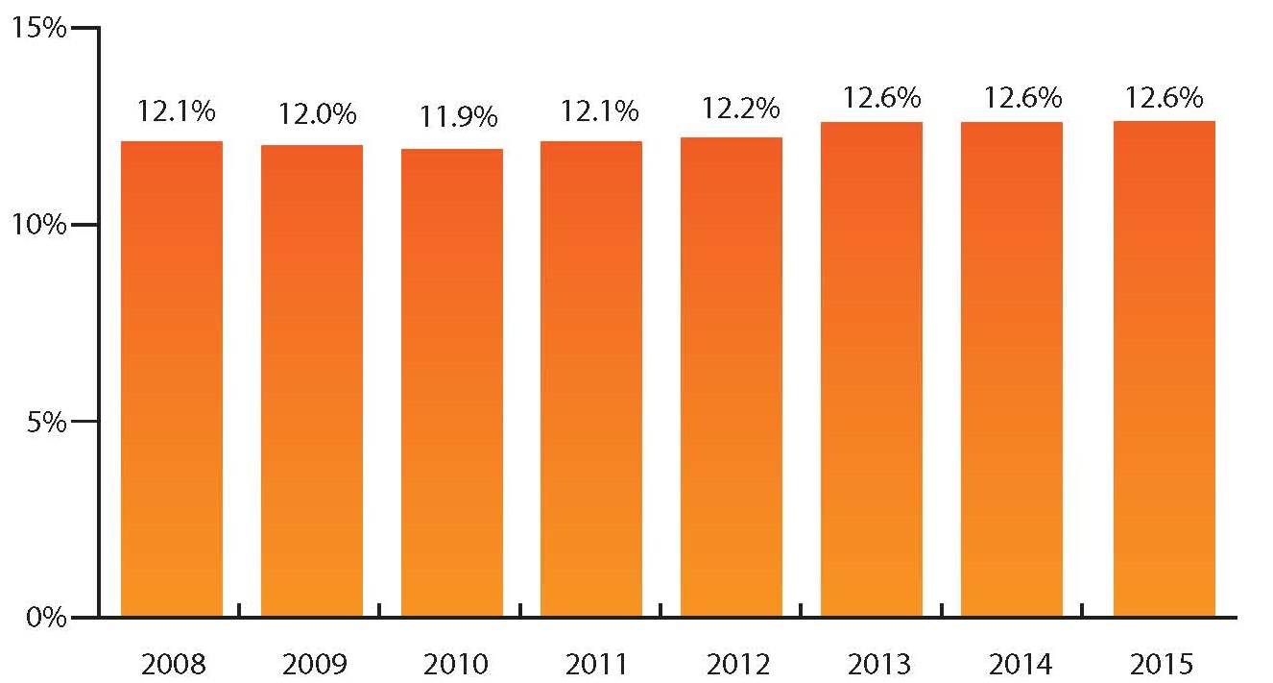
Percentage of People in the US with Disabilities, 2008-2015
Data Source: 2008-2015 American Community Survey, American FactFinder, Table B1810
4
Notes:
Over the past years, the consistency of the disability questions used in the survey allows for a look at the percentage of people with disabilities over time. The percentage of those with a disability in the US civilian population ranged from 11.9% in 2010 to 12.6% in 2013, 2014, and 2015.
*Other surveys have publicized other rates of disability. These rates are affected by survey question, method, and other factors. Each survey has strengths and weaknesses. Comparing disability data between surveys is discouraged by all survey organizations. We have used the ACS due to its larger sampling, consistent year to year questions, and multitude of variables to examine.

Slide 5
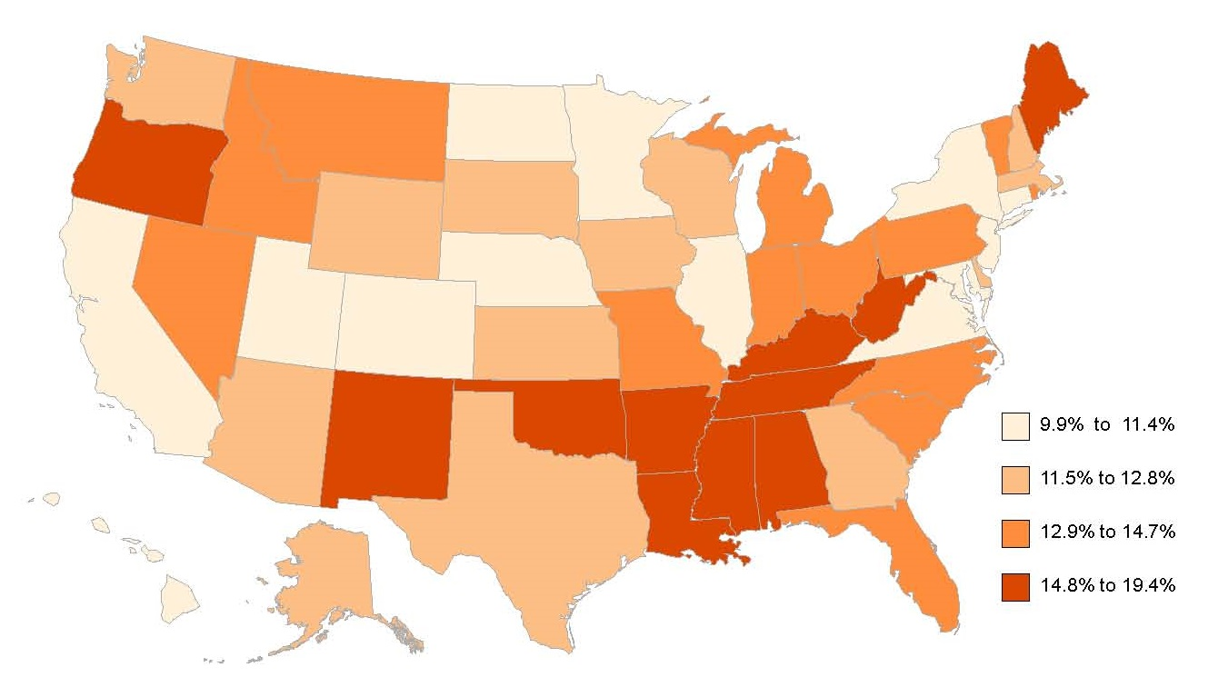
People with Disabilities Living in the Community as a Percentage of the US Population, by State, 2015
Data Source: 2015 American Community Survey, American FactFinder, Table B1810
5
Notes:
In 2015, the state with the lowest percentage of its population having a disability was Utah (9.9%). The state with the highest percentage of disability, West Virginia, was almost twice as high with a percentage of 19.4%. For the most part, higher percentages of disability were clustered in the southern US, around the lower Mississippi river region, with concentrations also high in the states of Maine and Oregon.

Slide 6
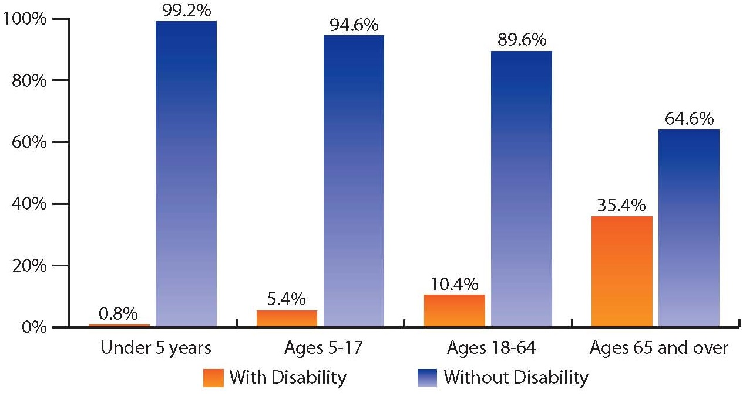
Age Distribution of Disability in the US Population, 2015
Data Source: 2015 American Community Survey, FactFinder Table B1810
6
Notes:
As the US population ages, the percentage of people with disabilities increases. This slide shows that in the US in 2015, less than 1.0% of the under 5 years old population had a disability. For those ages 5-17, the rate was 5.4%. For ages 18-64, the rate was 10.5%. For people ages 65 and older, 35.4% had a disability.

Slide 7
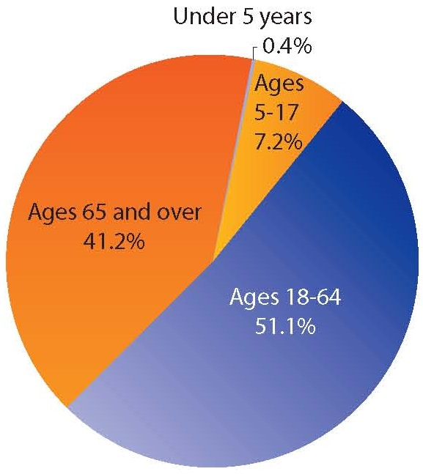
Age Distribution in the US Population of People with Disabilities, ACS, 2015
Data Source: 2015 American Community Survey, FactFinder Table B1810
7
Notes:
This slide shows the composition of the population of people with disabilities in the US, by age. Of the US population in 2015 with disabilities, over half (51.1%) were people in the working-ages of 18- 64, while 41.2% were 65 and older. Disability in children and youth accounted for only 7.2% (ages 5-17) and 0.4% (under 5 years old).

Slide 8
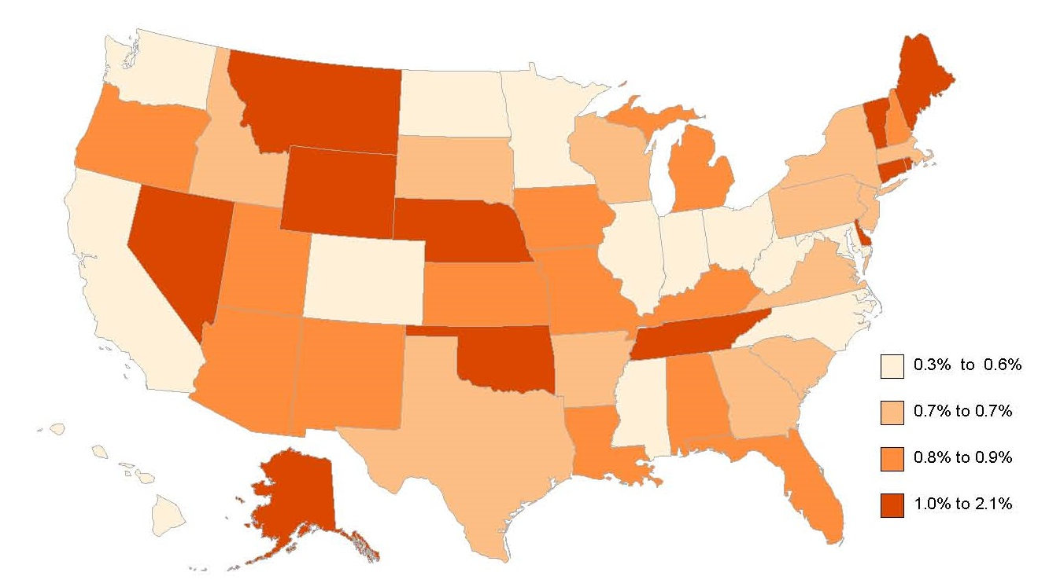
People with Disabilities Ages Under 5 Years Living in the Community, by State, 2015
Data Source: 2015 American Community Survey, FactFinder Table B1810
8
Notes:
The percentage of disability in those ages 5 and under was very low, about 0.8% nationally, and 2.1% or less in every state. The states with the highest percentages were Alaska and Nevada. Six states had percentages equal to or less than 0.5%.

Slide 9
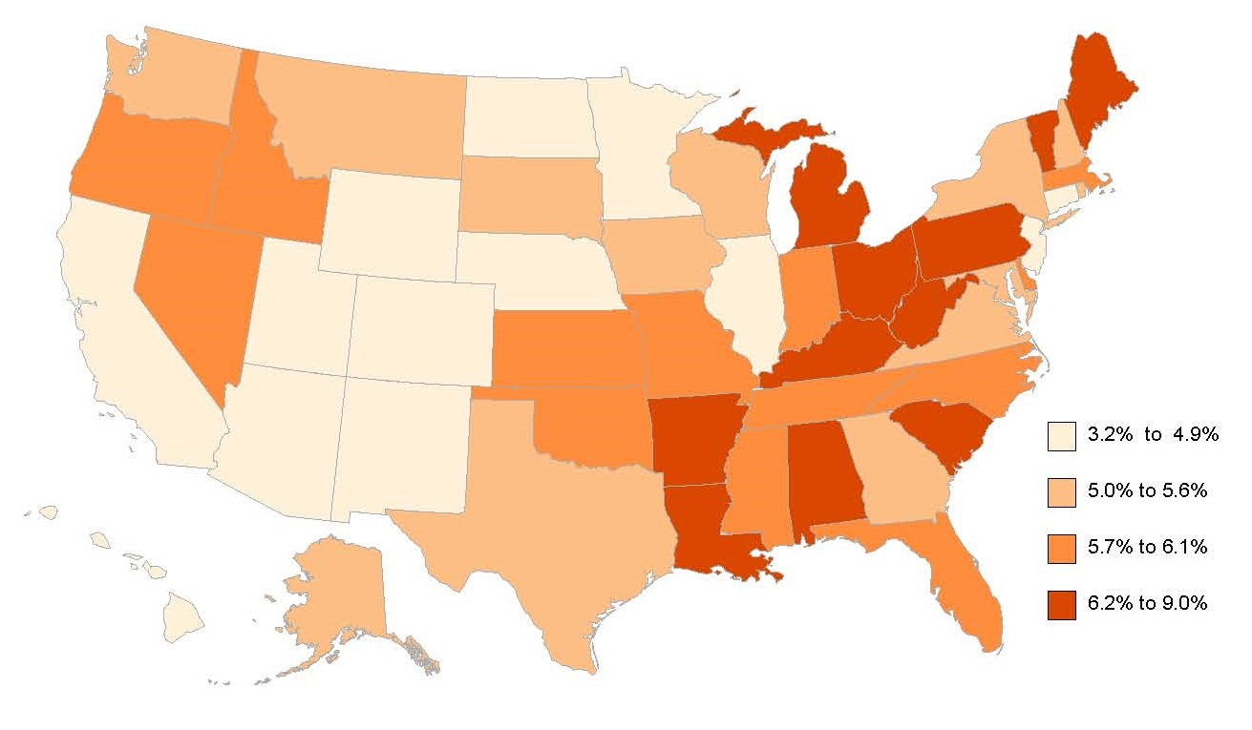
People with Disabilities Ages 5-17 Years Living in the Community, by State, 2015
Data Source: 2015 American Community Survey, FactFinder Table B1810
9
Notes:
For children ages 5-17, the percentages of those with a disability ranged from 3.2% in Hawaii to almost triple that percentage in Vermont at 9.0%. In general, percentages for this age group were lower in the states around the Rockies, the upper Great Plains, the Pacific Coast and Hawaii, and more concentrated in the eastern and southern US.

Slide 10
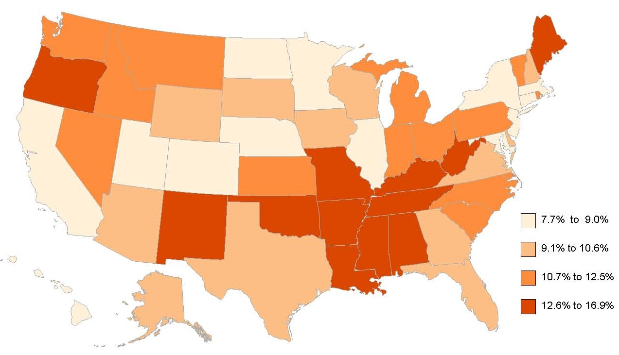
People with Disabilities Ages 18-64 Years Living in the Community, by State, 2015
Data Source: 2015 American Community Survey, FactFinder Table B1810
10
Notes:
For adults ages 18-64, the highest percentages of people with disabilities were in states in the southern US from Oklahoma to West Virginia, and also Maine and Oregon. The percentage was lowest in Hawaii and New Jersey (7.7%) and more than twice as high in West Virginia (16.9%).

Slide 11
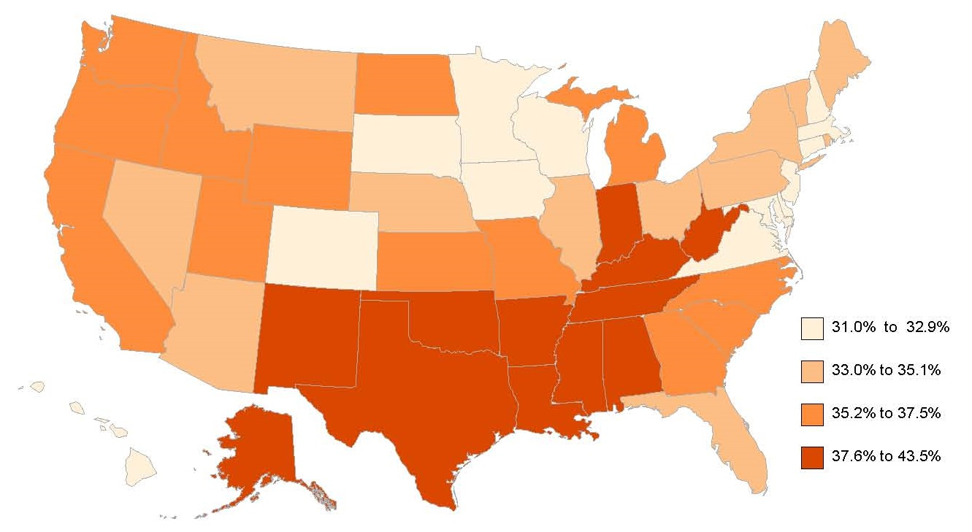
People with Disabilities Ages 65 and Over Living in the Community, by State, 2015
Data Source: 2015 American Community Survey, FactFinder Table B1810
11
Notes:
The highest percentages of people with disabilities were in the US population ages 65 and over; more than one third of the civilian population for this age group (35.4%) had a disability. In ten states, primarily in the South, the percentage of people ages 65 and over with disabilities was 40% or over, or more than two in every five elderly people: West Virginia, Mississippi, Arkansas, Alabama, Oklahoma, Kentucky, New Mexico, Louisiana, Tennessee, and Alaska.
The percentages of people with disabilities were generally lowest in the upper Midwest and Northeast; twelve states had disability percentages of less than one third (33.3%) of elderly: Connecticut, Delaware, Wisconsin, Maryland, Minnesota, South Dakota, New Jersey, New Hampshire, Colorado, Iowa, Virginia, Massachusetts, and Hawaii.

Slide 12
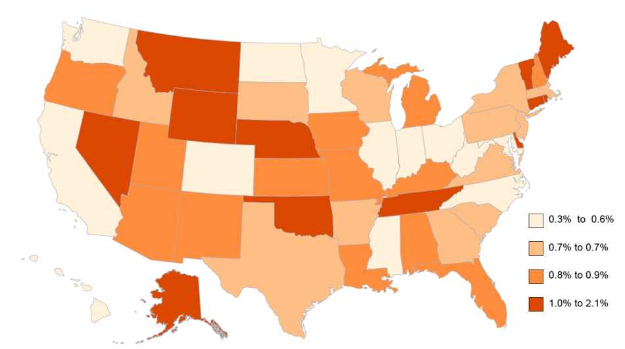
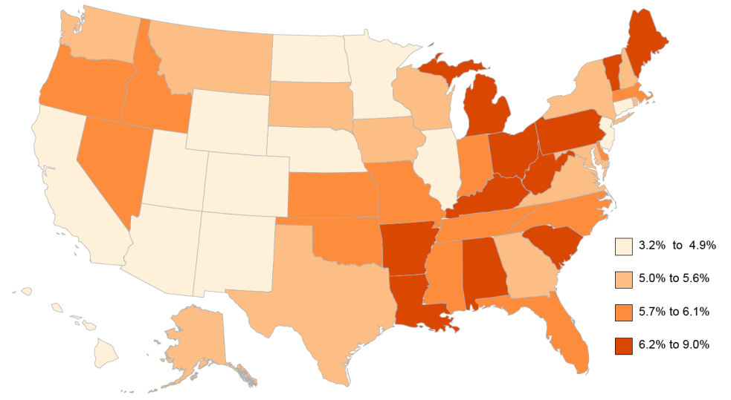
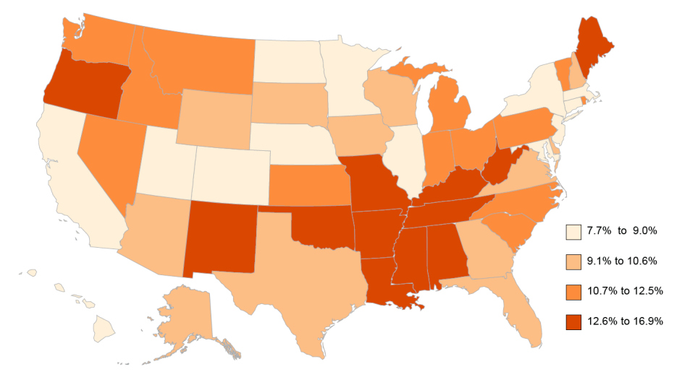
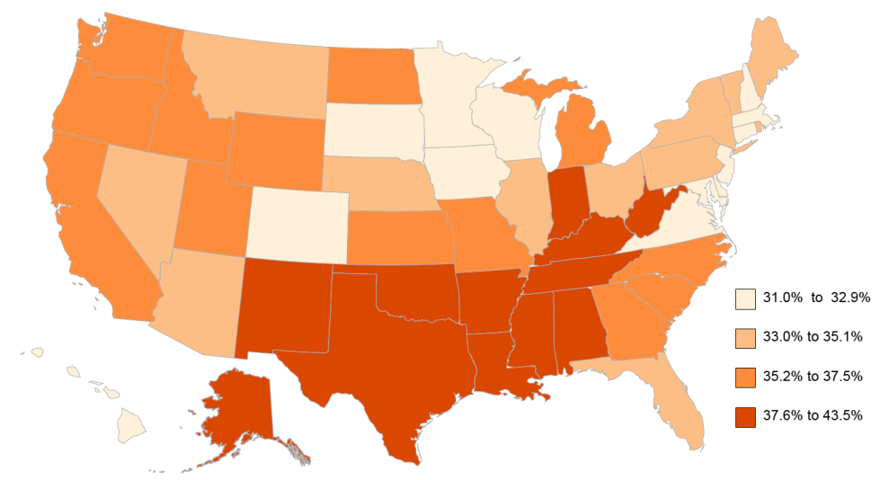
People with Disabilities Living in the Community, by Age Group and State, 2015
Under 5
5-17
18-64
65 and over
Data Source: 2015 American Community Survey, FactFinder Table B1810
12
Notes:
The Annual Report maps show state variation in the percentage of people with disabilities by age, demonstrating how disability increases with age. In the upper left, the percentage of disability in those ages 5 and under was very low, about 0.8% nationally, 2.1% or less in any state. The states with the highest percentages were Alaska and Nevada. Six states and the District of Columbia had percentages equal to or less than 0.5%. In the upper right, for children ages 5-17, the percentages of those with a disability ranged from 3.2% in Hawaii to almost triple that percentage in Vermont at 9.0%. In general, percentages for this age group were lower in the states around the Rockies, the upper Great Plains, the Pacific Coast and Hawaii, and more concentrated in the eastern and southern US. In the lower left, for adults ages 18-64, the highest percentages of people with disabilities were in states in the southern US from Oklahoma to West Virginia, and also Maine and Oregon. The percentage was lowest in Hawaii and New Jersey (7.7%) and more than twice as high in West Virginia (16.9%). In the lower right, the highest percentages of disability were in the US population 65 and over. In ten states, mainly in the South, the percentage was over 40%, or more than two in every five people. The percentages of people with disabilities were generally lowest in the upper Midwest and Northeast; twelve states had disability percentages of less than one third (33.3%).

Slide 13
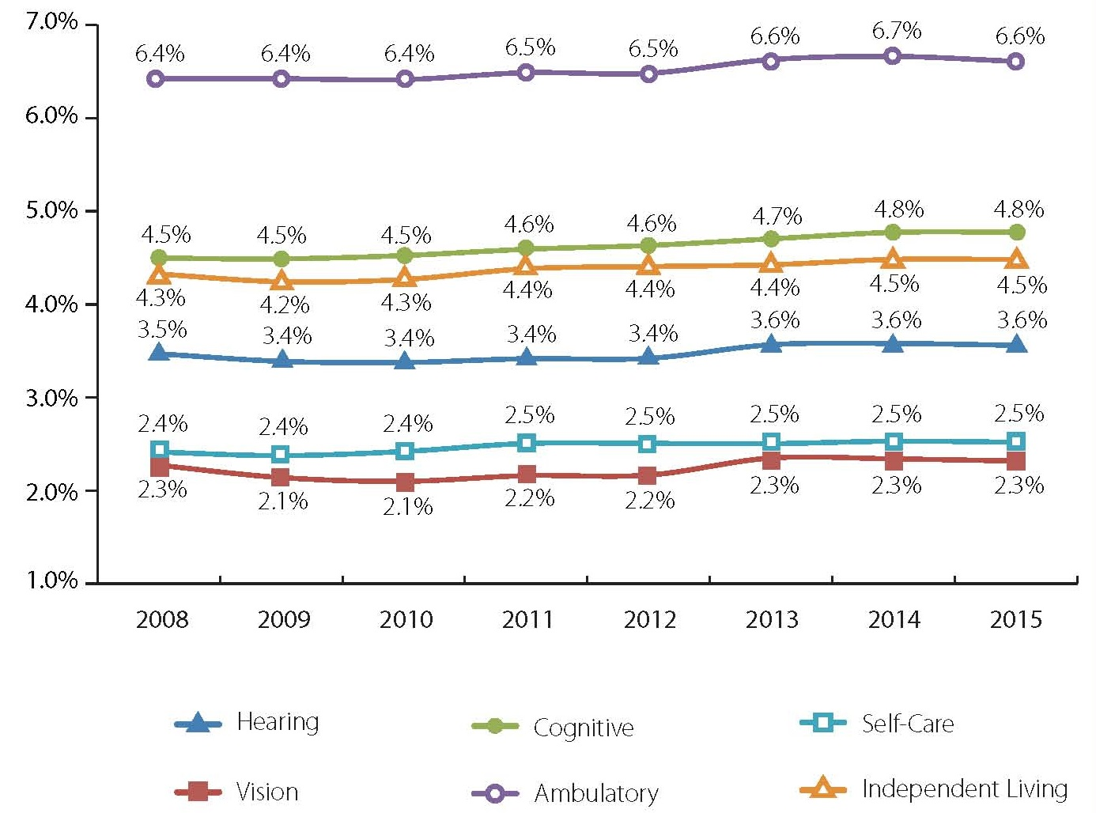
People with Disabilities, by Type and Year, 2008-2015
Data Source: 2008-2015 American Community Survey, FactFinder Table B1810
13
Notes:
The American Community Survey (ACS) asks about six types of disability: vision, hearing, cognitive, ambulatory, self-care, and independent living. From 2008 to 2015, the percentages of people with each type of disability have remained relatively unchanged. The Percentage of people with ambulatory disabilities, cognitive disabilities, and independent living disabilities rose by 0.2 to 0.3 points over the period, while people with hearing, vision, and self-care disabilities rose 0.1 point or less.

Slide 14
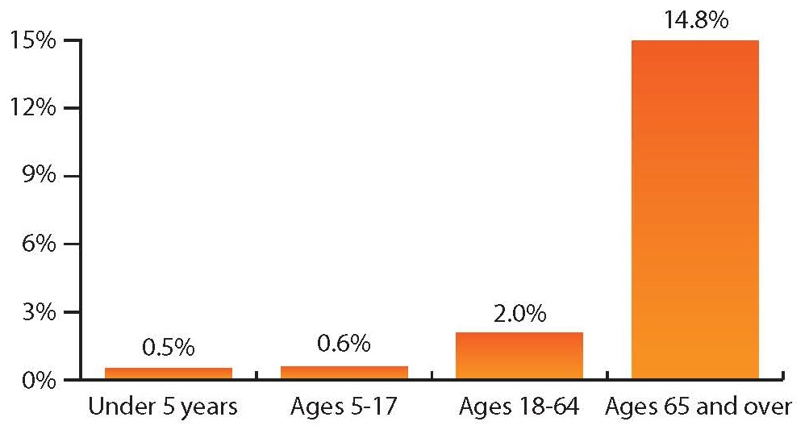
People with Hearing Disability, by Age Group, 2015
Data Source: 2015 American Community Survey, FactFinder Table B1810
14
Notes:
In the US in 2015, an estimated 3.6% of the US population had a hearing disability. Hearing disability is connected strongly with age: there are very low percentages in the under 5 and 5-17 age groups (0.5% and 0.6% respectively), rising to 2.0% of 18-64 year olds, and to 14.8% of those ages 65 and over.

Slide 15
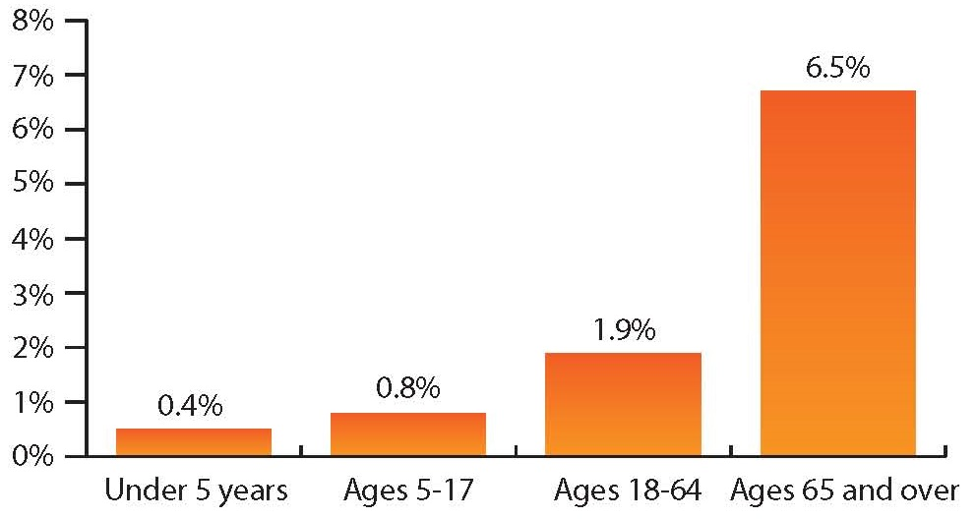
People with Vision Disability, by Age Group, 2015
Data Source: 2015 American Community Survey, FactFinder Table B1810
15
Notes:
This slide shows that vision disability also is connected strongly with age. Only 0.4% of those ages 5 and under, 0.8% of the 5-17 age group, and 1.9% of 18-64 year olds had a vision disability. For those 65 and over, the percentage increases to 6.5%.

Slide 16
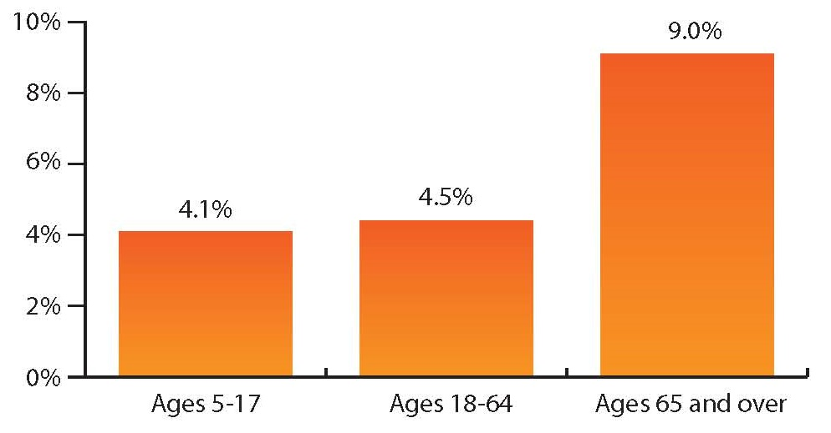
People with Cognitive Disability, by Age Group, 2015
Data Source: 2015 American Community Survey, FactFinder Table B1810
16
Notes:
The national prevalence percentage for civilians with cognitive disabilities increases with age, starting at 4.1% for those ages 5-17, rising to 4.5% for those 18-64, and doubling to 9.0% for those ages 65 and over. Data for those younger than age 5 is not collected.

Slide 17
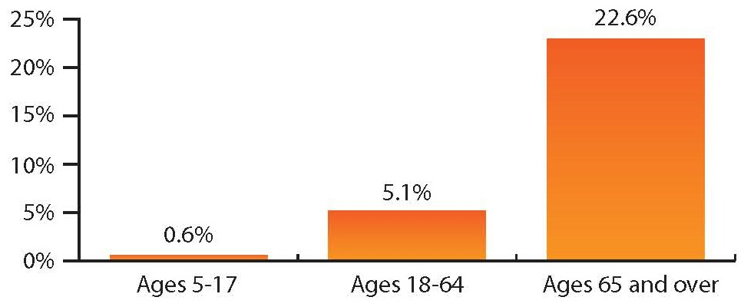
People with Ambulatory Disability, by Age Group, 2015
Data Source: 2015 American Community Survey, FactFinder Table B1810
17
Notes:
This slide shows in 2015, the percentage of people with ambulatory disabilities increases rapidly with age. In those ages 5-17, the rate was a very low 0.6%. For those ages 18-64 the rate jumps to 5.1%. The rate then leaps to 22.6% for those ages 65 and over. Data for those younger than age 5 is not collected.

Slide 18
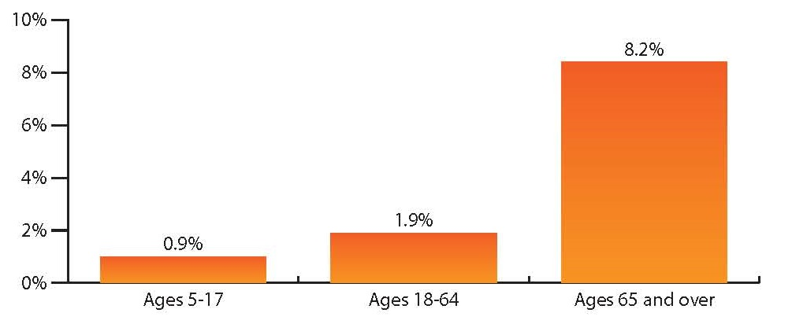
People with Self-Care Disability, by Age Group, 2015
Data Source: 2015 American Community Survey, FactFinder Table B1810
18
Notes:
As with the other disabilities, the national percentage of civilians with a self-care disability rises with age. The percentage was 0.9% for those ages 5-17, 1.9% for those ages 18- 64, and 8.2% for those ages 65 and over. Data for those younger than age 5 is not collected.

Slide 19
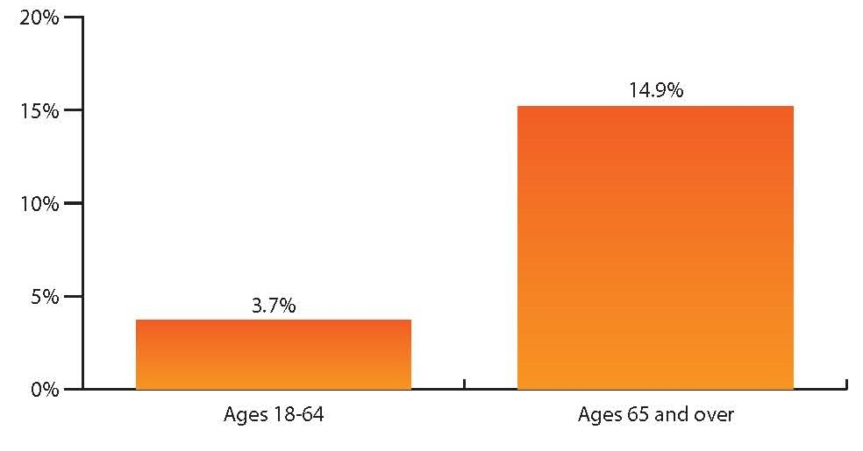
People with Independent Living Disability, by Age Group, 2015
Data Source: 2015 American Community Survey, FactFinder Table B1810
19
Notes:
The national percentage for people ages 18-64 with an independent living disability was 3.7%. As this slide shows, for those ages 65 and over, however, the percentage increases more than four-fold to 14.9%. Data for those younger than age 18 is not collected.

Slide 20
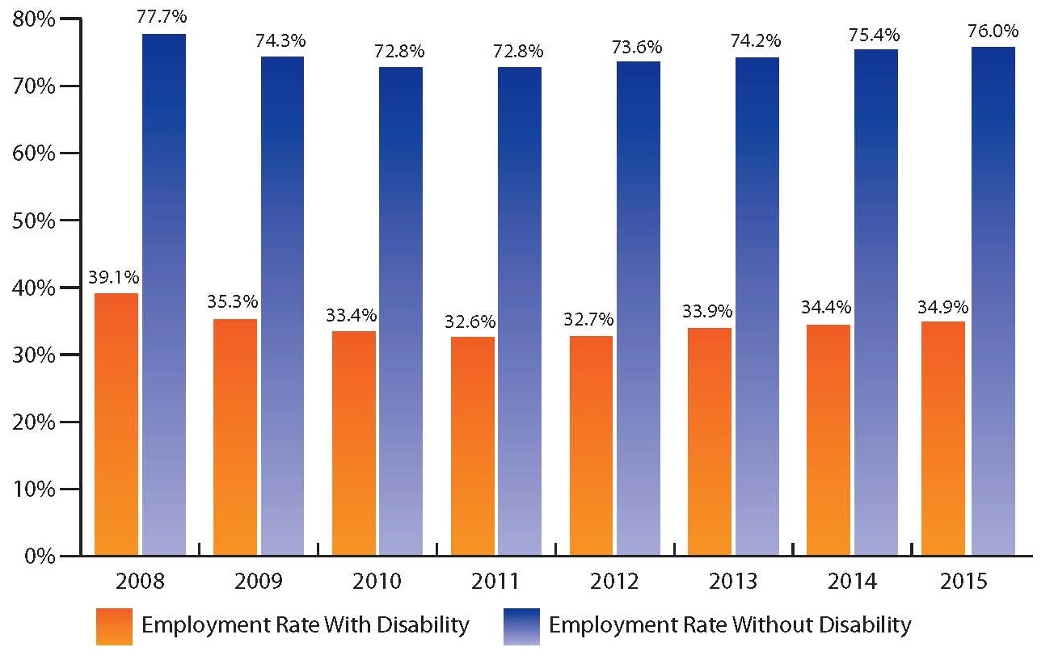
Employment Percentage, with and without Disability, 2008-2015
Data Source: 2008- 2015 American Community Survey, American FactFinder, Table B18120
20
Notes:
This slide shows, in the US in 2015, 34.9% of people with disabilities ages 18-64 living in the community were employed. The employment percentage was more than double for people without disabilities, 76.0%. Figure 16 also shows this continuing pattern of difference in employment between people with and without disabilities since 2008, spanning an economic downturn and recovery.

Slide 21
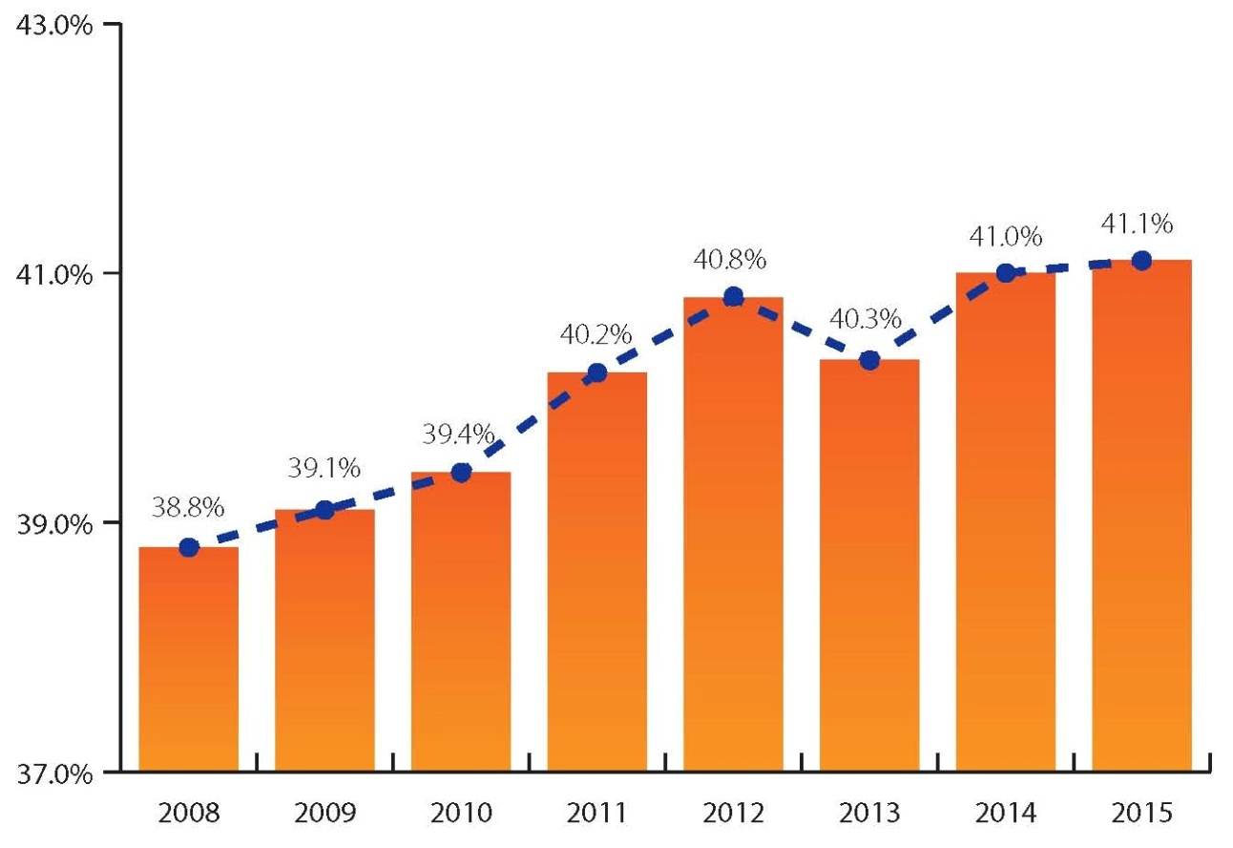
Employment Gap Among those with and without Disability, 2008-2015
Data Source: 2008- 2015 American Community Survey, American FactFinder, Table B18120
21
Notes:
The employment gap is the difference between the respective employment percentages of people with and without disabilities. In the US in 2015, the difference between the employment percentage for people with disabilities (34.9%) and people without disabilities (76.0%) was 41.1 percentage points. This slide shows this gap has widened steadily over the past 8 years from 38.8 to 41.1 percentage points.

Slide 22
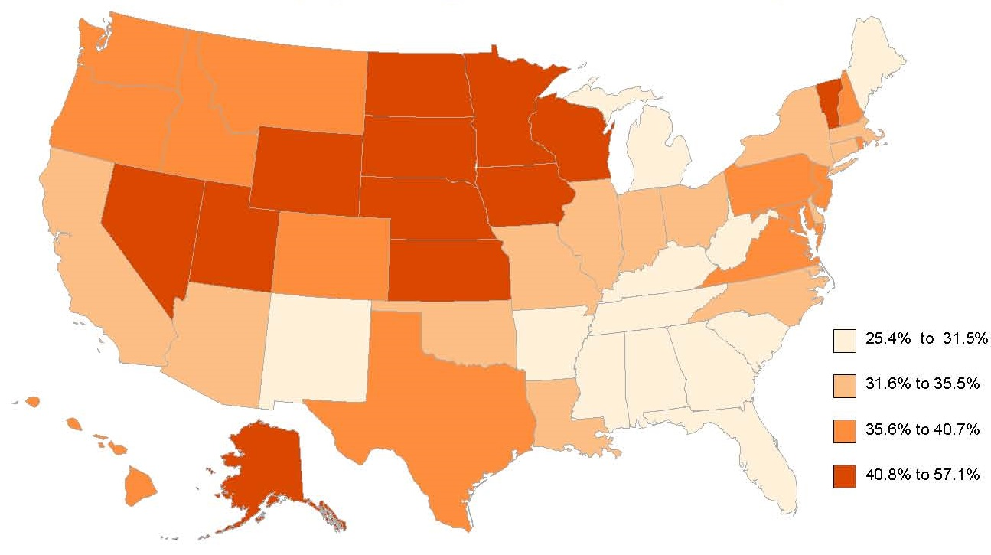
Percent Employed Among People with Disabilities, by State, 2015
Data Source: 2015 American Community Survey, American FactFinder, Table B18120
22
Notes:
This slide depicts how rates of employment varied by state. For people with disabilities, employment rates ranged from a high of 57.1% (Wyoming) to a low of 25.4% (West Virginia). For those without disabilities, the employment ranged from 70.1% (Mississippi) to 83.8% (Minnesota).

Slide 23
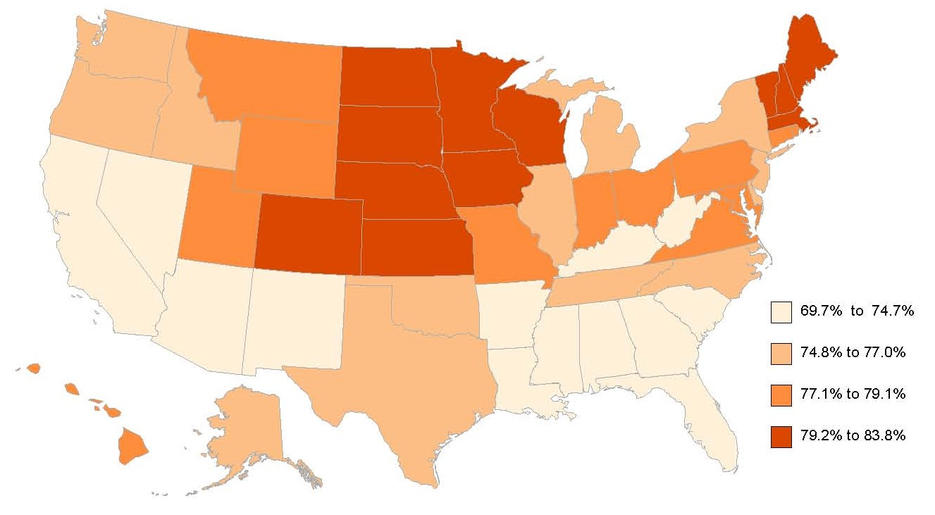
Percent Employed Among People without Disabilities, by State, 2015
Data Source: 2015 American Community Survey, American FactFinder, Table B18120
23
Notes:
This slide shows that for those without disabilities, the employment ranged from 70.1% (Mississippi) to 83.8% (Minnesota).

Slide 24
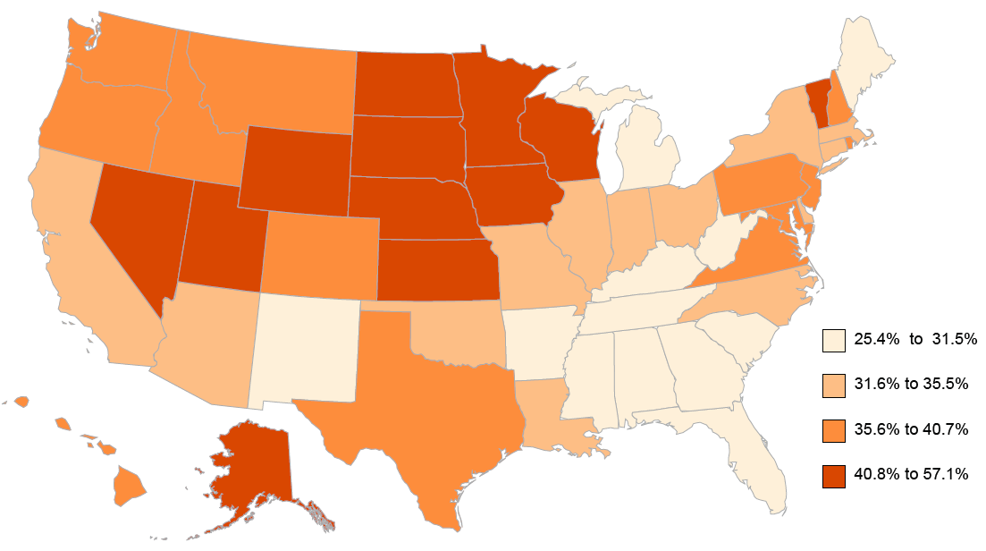
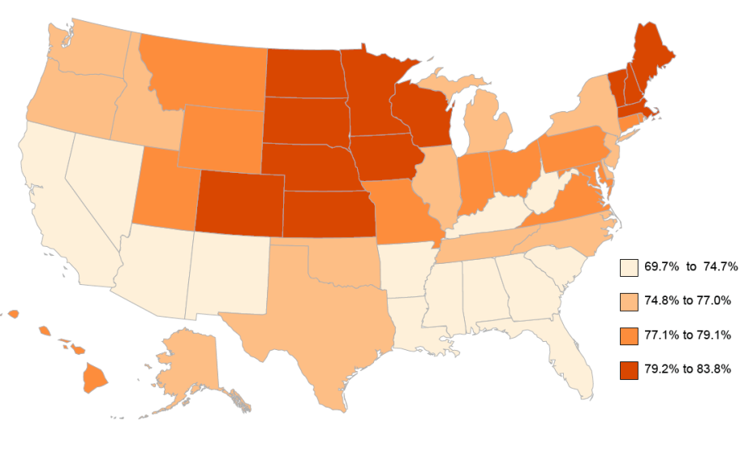
Percent of Persons With and Without Disabilities Employed, by State, 2015
With Disabilities Without Disabilities
Data Source: 2015 American Community Survey, American FactFinder, Table B18120
24
24
Notes:
These maps depict how rates of employment varied by state. For persons with disabilities (left map), rates ranged from a high of 57.1% (Wyoming) to a low of 25.4% (West Virginia). For those without disabilities (right map), the employment percentages ranged from 70.1% (Mississippi) to 83.8% (Minnesota).

Slide 25
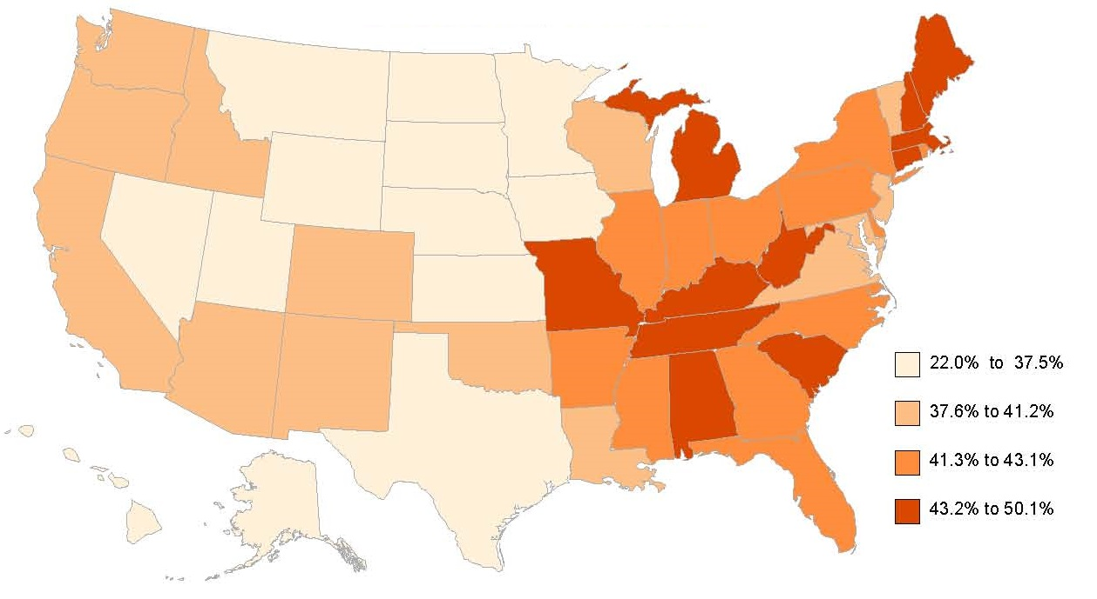
Gap of Percent Employed Among People with and without Disabilities, by State, 2015
Data Source: 2015 American Community Survey, American FactFinder, Table B18120
25
Notes:
This slide shows the gap in percent employment between those with and without disabilities by state in 2015. States with the highest gap were concentrated from the Atlantic Coast to Missouri and Arkansas. In thirty (30) states, the employment percentage gap was 40 percentage points or greater. The highest gap was found in Maine (50.1%), Kentucky (47.4%), and the District of Columbia (46.1%). In only three states was the gap less than 33.3% - Wyoming (22.0%), South Dakota (30.9%), and Utah (32.5%).

Slide 26
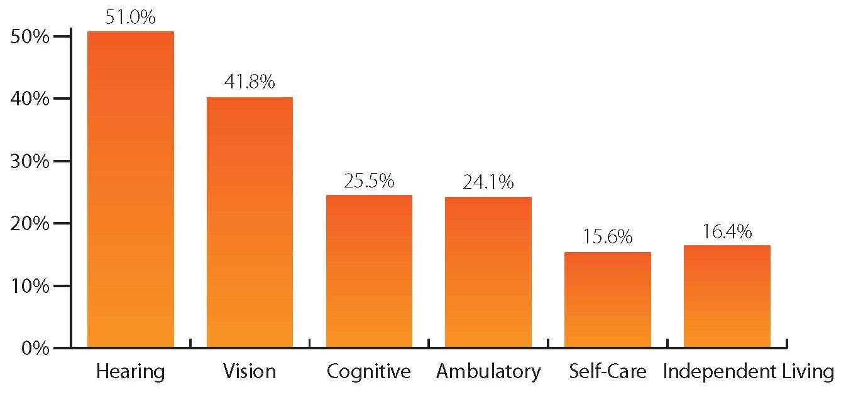
Employment Percentage by Type of Disability, Ages 18-64, 2015
Data Source: 2015 American Community Survey, American FactFinder, Table B18120
26
Notes:
This slide shows how employment percentages varied by type of disability. Employment percentages were highest for people with hearing disabilities (51.0%) and vision disabilities (41.8%) and lowest for self-care (15.6%) and independent living (16.4%) disabilities.

Slide 27
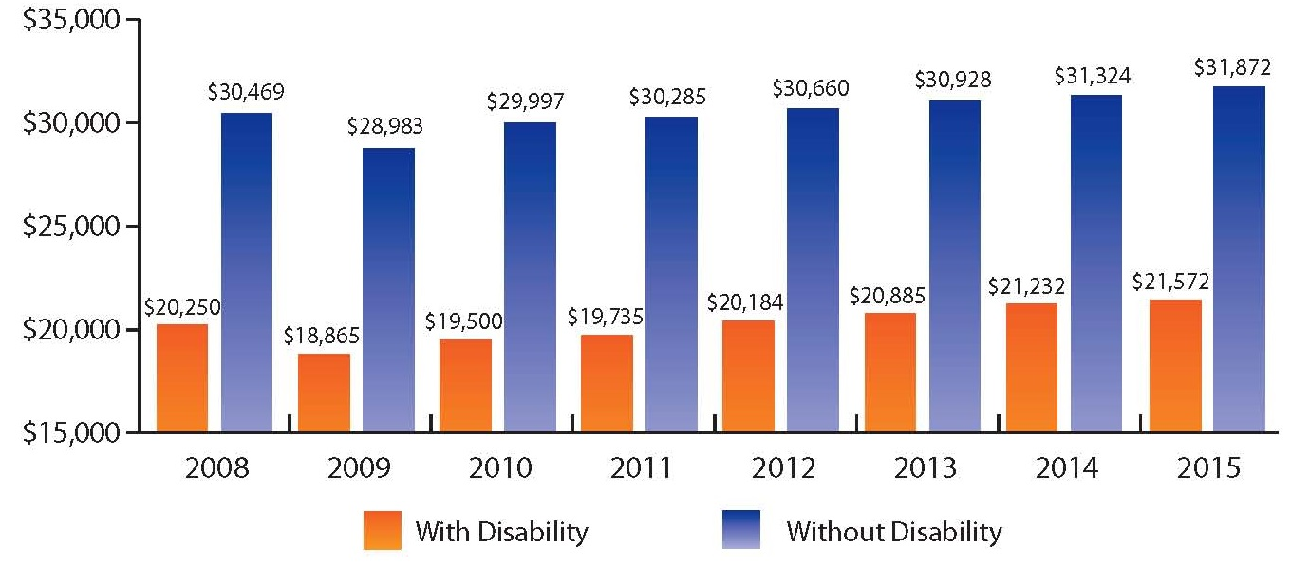
Median Earnings, People with and without Disabilities, Ages 16 and Over, 2008-2015
Data Source: 2008- 2015 American Community Survey, American FactFinder, Table B18140
27
Notes:
In 2015, the median earnings of people with disabilities ages 16 and over in the US was $21,572, about two-thirds of the median earnings of people without disabilities, $31,874.

Slide 28
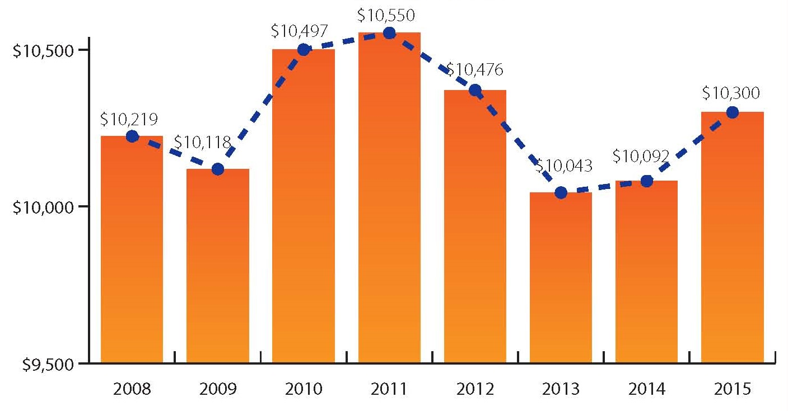
Median Earnings Gap Among People with and without Disabilities, by State, 2008-2015
Data Source: 2008- 2015 American Community Survey, American FactFinder, Table B18140
28
Notes:
This disparity of over $10,000 in median earnings between those with and without disabilities continues a trend, which has existed since at least 2008 and has increased in magnitude since 2013.

Slide 29
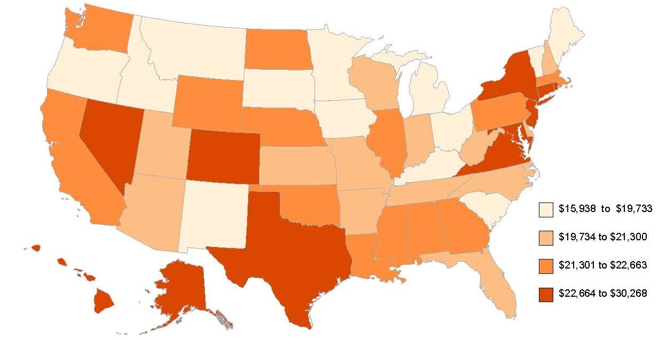
State Median Earnings, Past 12 Months, Ages 16 and Over with Disability, 2015
Data Source: 2015 American Community Survey, American FactFinder, Table B18140
29
Notes:
This slide shows the range of median earnings in states for people with disabilities in 2015 was $15,938 in Idaho to $30,268 in Alaska. In six states (Alaska, Maryland, Hawaii, Nevada, New Jersey, and District of Columbia), the median earnings for people with disabilities was over $25,000, while fourteen (14) states had median disability earnings lower than $20,000.

Slide 30
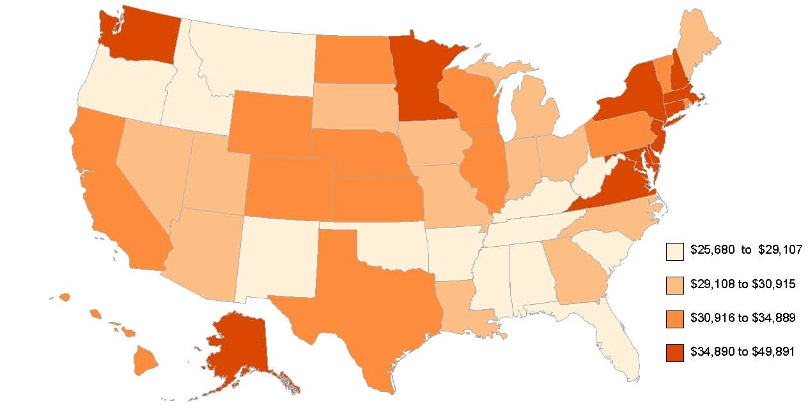
State Median Earnings, Past 12 Months, Ages 16 and Over without Disability, 2015
Data Source: 2015 American Community Survey, American FactFinder, Table B18140
30
Notes:
In comparison to the last slide, the median earnings for people without disabilities ages 16 and over ranged from $25,680 in Idaho to $49,891 in the District of Columbia in 2015.

Slide 31
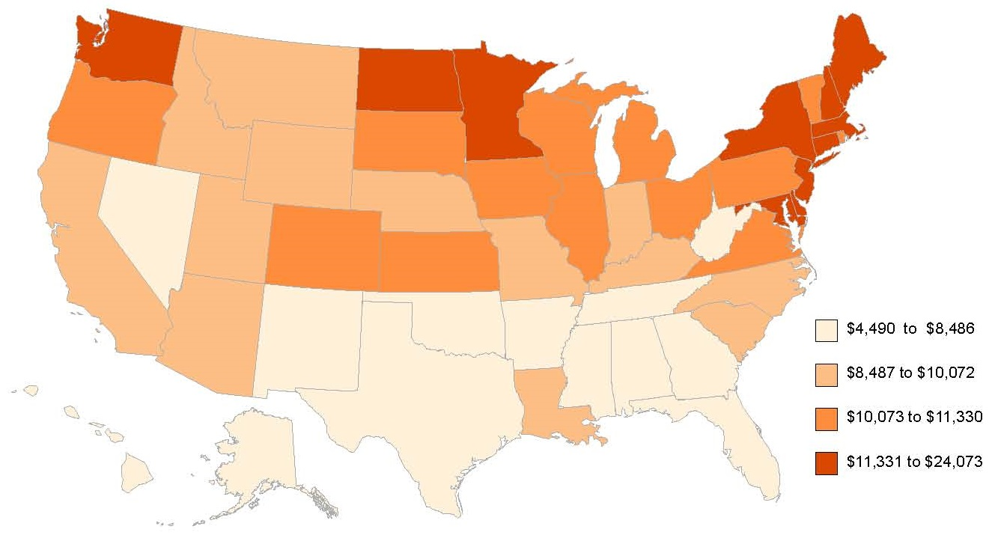
Median Earnings Gap of People 16 Years and Over in the Past 12 Months, by State, 2015
Data Source: 2015 American Community Survey, American FactFinder, Table B18140
31
Notes:
States varied widely in earnings gap (the difference between the median earnings for those with and without disabilities) – from a low of $4,490 in Nevada to a high of $24,073 in the District of Columbia. Generally, states in the northern US had a higher earnings gap; states in the southern US had a lower earnings gap.

Slide 32
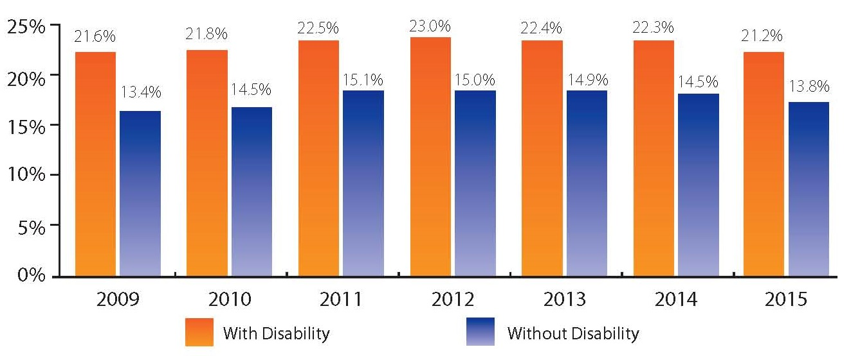
Poverty Percentage, People with and without Disabilities, 2009-2015
Data Source: 2009- 2015 American Community Survey, American FactFinder, Table B18130
32
Notes:
Poverty among people with and without disabilities rose from 2009 through 2011 and 2012 and then dropped through 2015. For people with disabilities, the percentage increased from 21.6% in 2009 to 23.0% in 2012, then dropped to 21.2% in 2015. For people without disabilities, the percentage increased from 13.4% in 2009 to 15.1% in 2011, then dropped to 13.8% in 2015.

Slide 33
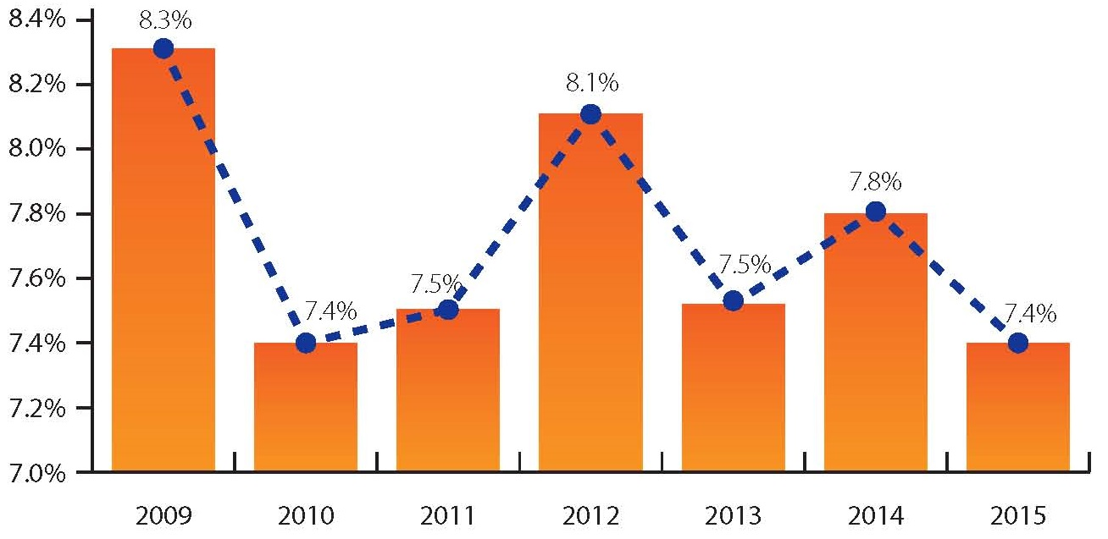
Poverty Percentage Gap Among People with and without Disabilities, 2009-2015
Data Source: 2009- 2015 American Community Survey, American FactFinder, Table B18130
33
Notes:
The poverty percentage gap, or the difference between the percentages of those with and without disabilities, has been between 7.4 and 8.3 percentage points over the 7 years from 2009 to 2015. The gap was over 8 percentage points in 2009 (8.3) and 2012 (8.1). The other years, the gap ranged from 7.4 (2010 and 2015) to 7.8 percentage points (2014).

Slide 34
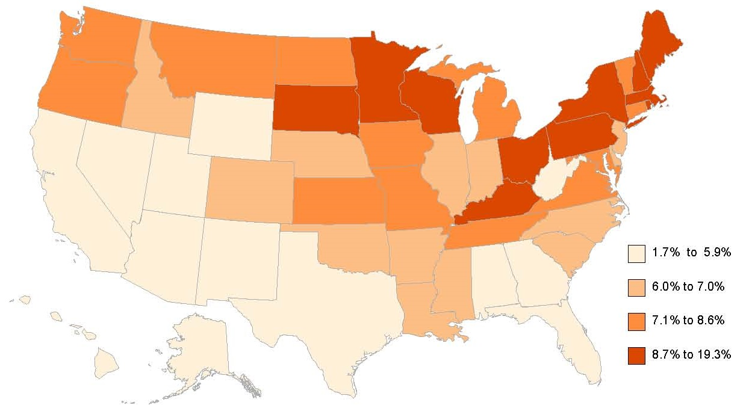
Poverty Percentage Gap Among People with and without Disabilities, by State, 2015
Data Source: 2015 American Community Survey, American FactFinder, Table B18130
34
Notes:
This slide shows the poverty gap between those with and without disabilities by state in 2015. The highest poverty gaps were seen mostly in the Northeast US, states bordering the Great Lakes, and those on the northern border with Canada. Gaps ranged from a high of 19.3 percentage points (District of Columbia) to a low of 1.7 percentage points in Wyoming.

Slide 35
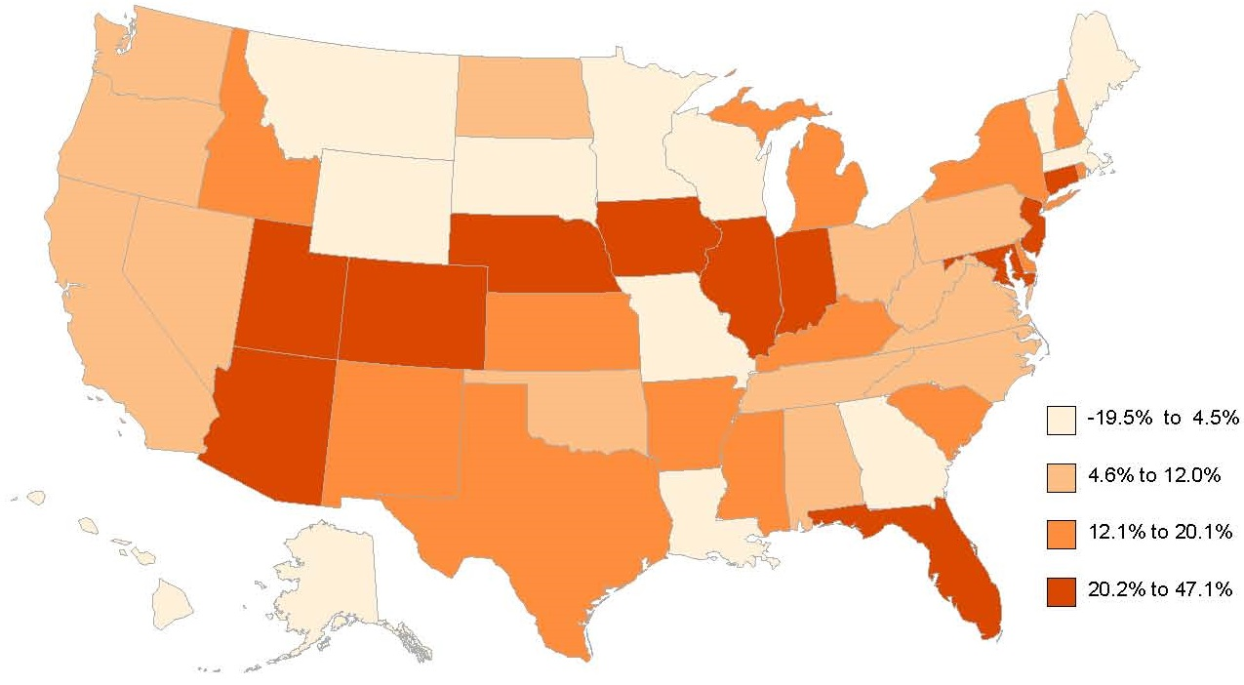
Poverty Percentage Gap Among People Ages 5 and Under with and without Disabilities, by State, 2015
Data Source: 2015 American Community Survey, American FactFinder, Table B18130
35
Notes:
For children under age 5, the poverty gap was highest in District of Columbia (47.1 percentage points), Nebraska (36.8), and Utah (33.6). For children ages 5 and under, eight states had a negative poverty gap (a higher percentage of those without disabilities were in poverty than those with disabilities) – Maine (-19.5), Montana (-18.5), Vermont (-15.7), South Dakota (-9.9), Hawaii (-5.9), Louisiana (-1.1), Minnesota (-0.7), and Alaska (-0.3).

Slide 36
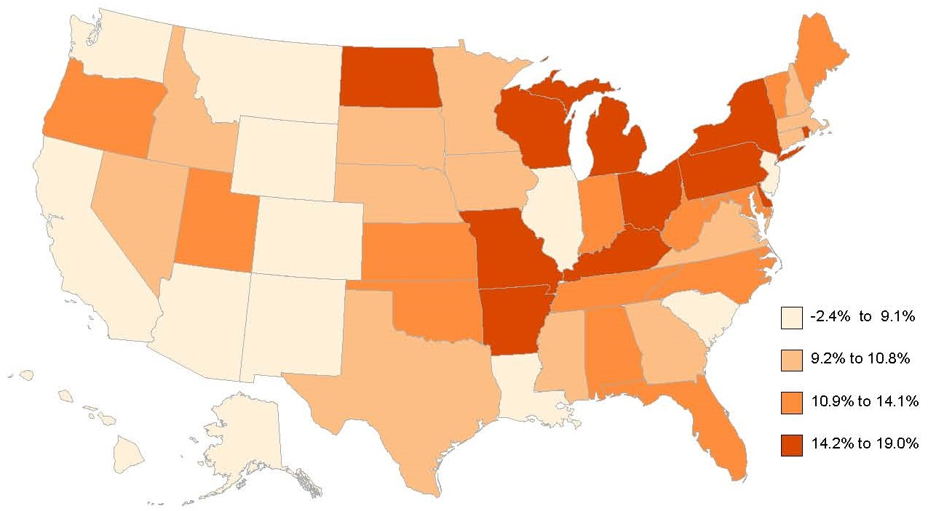
Poverty Percentage Gap Among People Ages 5-17 with and without Disabilities, by State, 2015
Data Source: 2015 American Community Survey, American FactFinder, Table B18130
36
Notes:
The poverty gap for those ages 5-17 with and without a disability ranged from a low of -2.4 percentage points in Wyoming to 19 points in Kentucky. Wyoming was the only state with a negative poverty gap in this age group.
There are 8 states with a gap of a least 15 points, and 31 with a gap of at least 10 points, meaning that in 39 states the poverty rates were 10-15 or more percentage points higher for those with disabilities than for those without disabilities.

Slide 37
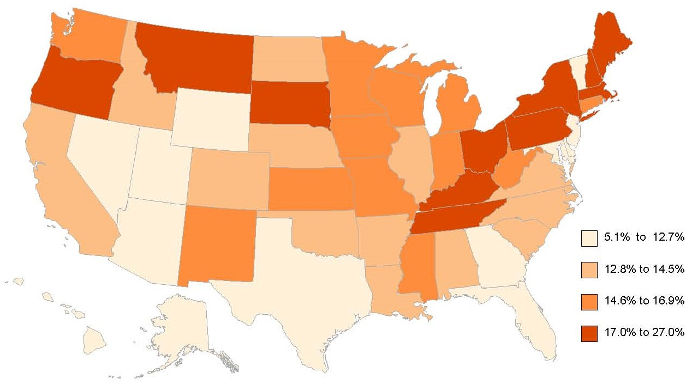
Poverty Percentage Gap Among People Ages 18-64 with and without Disabilities, by State, 2015
Data Source: 2015 American Community Survey, American FactFinder, Table B18130
37
Notes:
For people in the 18-64 year old working-age, the poverty gap between those with and without disabilities ranged from a low of 5.1 percentage points in Wyoming to a high of 27 points in District of Columbia. Nearly half of the states (24) had gaps of 15 points or more. All but 3 states had gaps over 10 points or more.

Slide 38
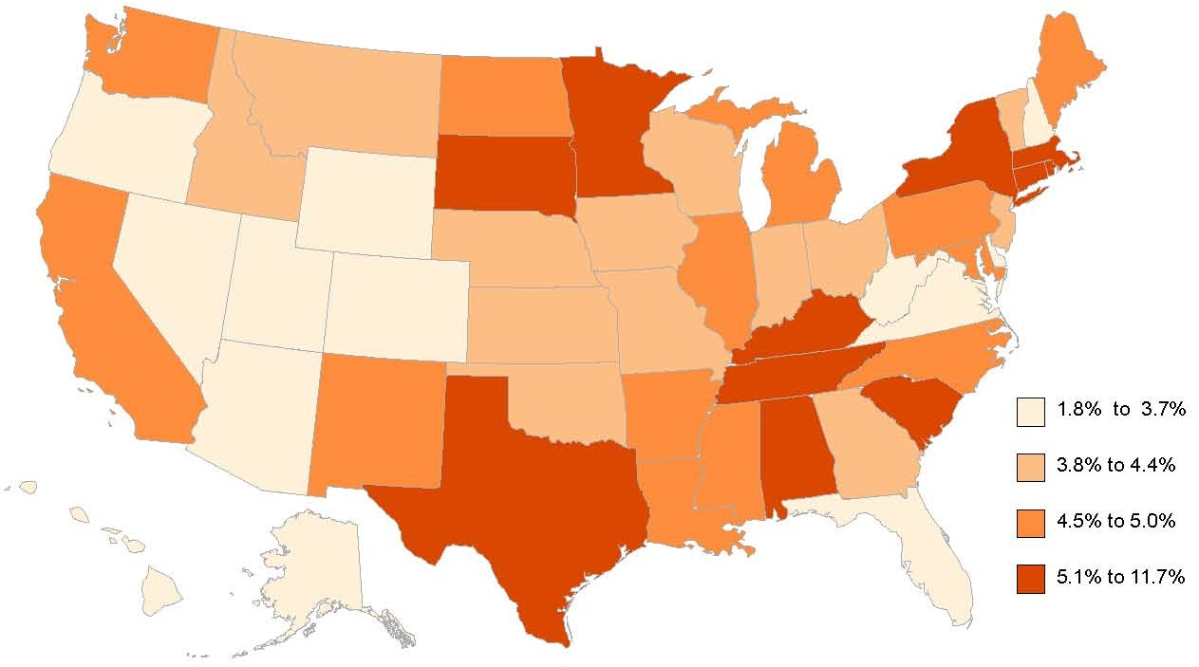
Poverty Percentage Gap Among People Ages 65 and Over with and without Disabilities, by State, 2015
Data Source: 2015 American Community Survey, American FactFinder, Table B18130
38
Notes:
Poverty gaps for those age 65 and over with and without disabilities had a low of 1.8 percentage points (Alaska) to 11.7% (District of Columbia) in 2015. DC was the only place to have a gap above 10 percentage points in this age group. Three states had gaps below 3 points (Alaska, Wyoming, and West Virginia).

Slide 39
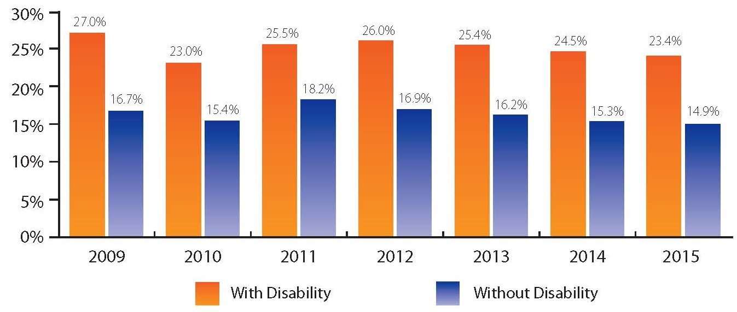
Smoking Percentages, with and without Disabilities, 2009-2015
Data Source: Authors' calculations using data from the 2009-2015 Behavioral Risk Factor Surveillance Survey BRFSS
39
Notes:
The highest percentage of people with disabilities who smoke was 27.0% in 2009 but has been in annual decline since 2012 (from 26.0% to 23.4%). Over the same period, the highest percentage of people without disabilities smoking was 18.2% in 2011 and it has been in annual decline thereafter to 14.9% in 2015.

Slide 40
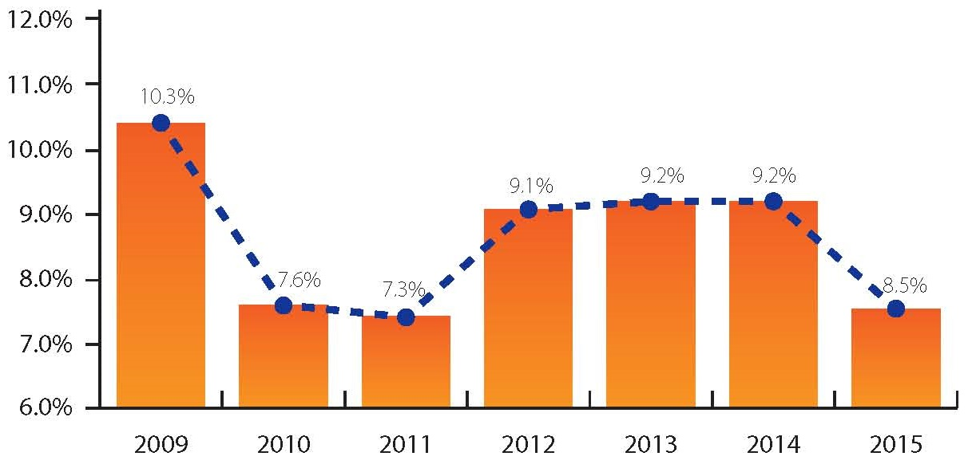
Smoking Percentages Gap Among People with and without Disabilities, 2009-2015
Data Source: Authors' calculations using data from the 2009-2015 Behavioral Risk Factor Surveillance Survey BRFSS
40
Notes:
The gap between the percentages for smokers with and without disabilities dropped in 2015 to 8.5 percentage points. The prior three years had a gap of 9.1 to 9.2 points. These gaps were higher than in 2010 and 2011 (7.6 and 7.3 points) but lower than in 2009 (10.3 points).

Slide 41
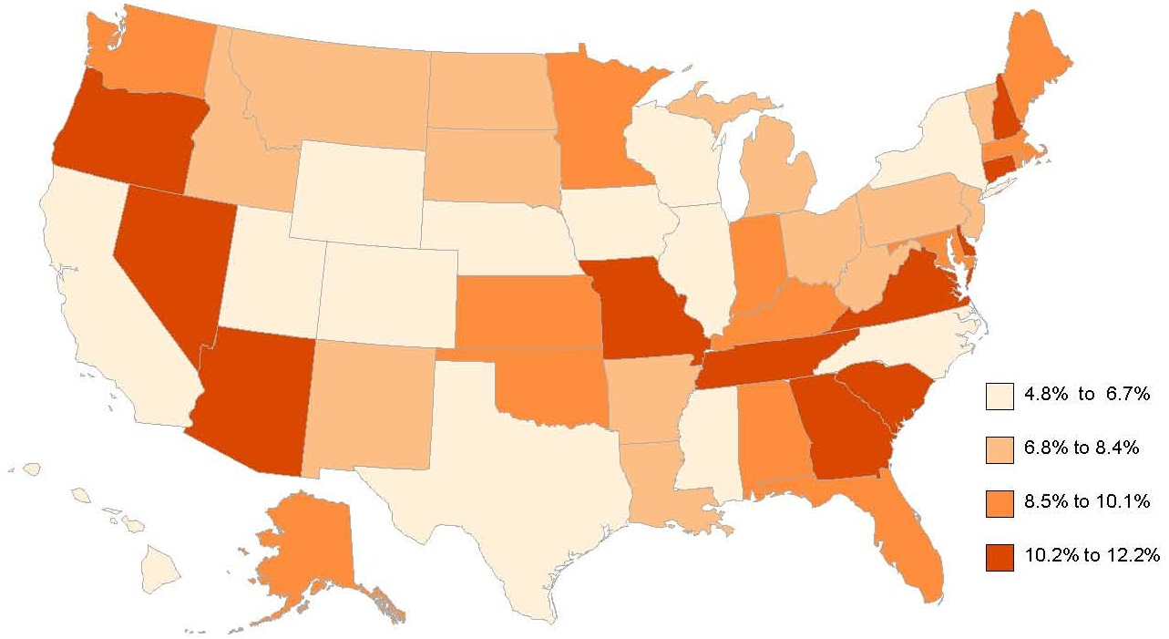
Smoking Percentages Gap Among People with and without Disabilities By State, 2015
Data Source: Authors' calculations using data from the 2015 Behavioral Risk Factor Surveillance Survey BRFSS
41
Notes:
The gap between smokers with and without disabilities by state in 2015 ranged from a low of 4.8 percentage points in Mississippi to a high of 12.2 points in Missouri. Thirteen states had a gap of 10 percentage points or higher; eight states had a gap of 6 percentage points or lower.

Slide 42
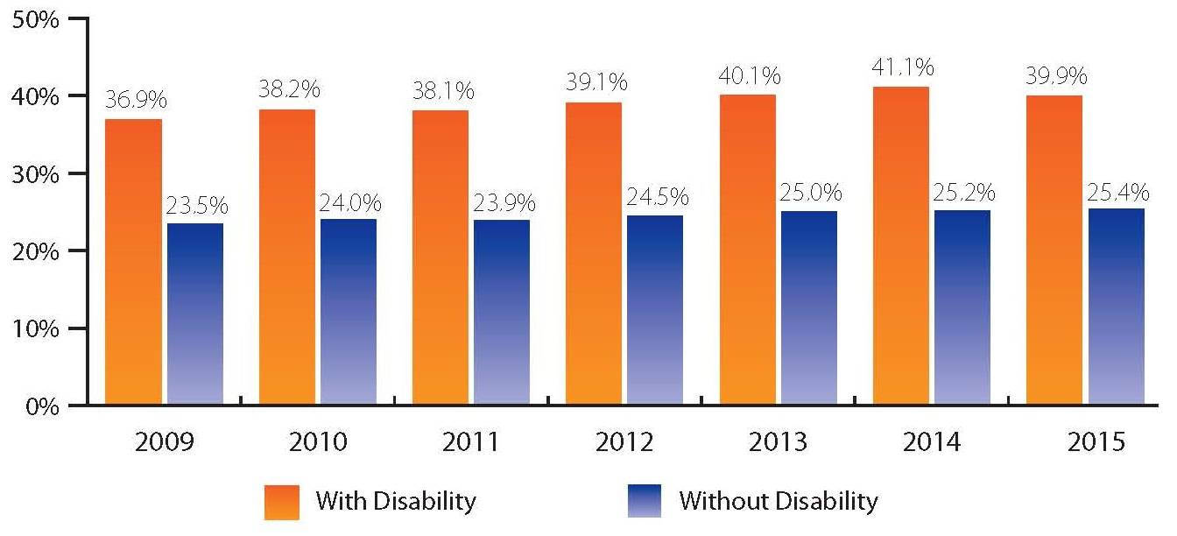
Obesity Percentages, with and without Disabilities, 2009-2015
Data Source: Authors' calculations using data from the 2009-2015 Behavioral Risk Factor Surveillance Survey BRFSS
42
Notes:
In 2015, 39.9% of people ages 18 and over with disabilities were obese. In comparison, only 25.4% of those without disabilities were obese.
This slide shows that 2015 marked the first year since 2009 to show a year-to-year decline in the percentage of people with disabilities who were obese. Until 2015, the obesity percentage had increased for people with disabilities (from 36.9% in 2009 to 41.1% in 2014). For people without disabilities, the obesity percentage has continued to climb every year (from 23.5% in 2009 to 25.4% in 2015).

Slide 43
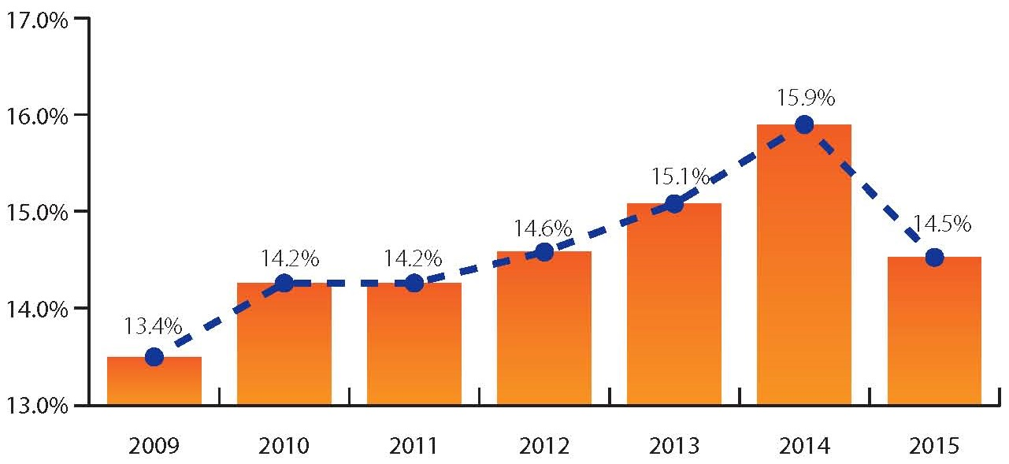
Obesity Percentages Gap Among People with and without Disabilities, 2009-2015
Data Source: Authors' calculations using data from the 2009-2015 Behavioral Risk Factor Surveillance Survey BRFSS
43
Notes:
2015 also showed the first year-to-year drop in obesity gap (the difference in the percentages of obesity for people with and without disabilities) since 2009. The gap increased from 13.4 points in 2009 to 15.9 in 2014, then dropped back to 14.5 points in 2015.

Slide 44
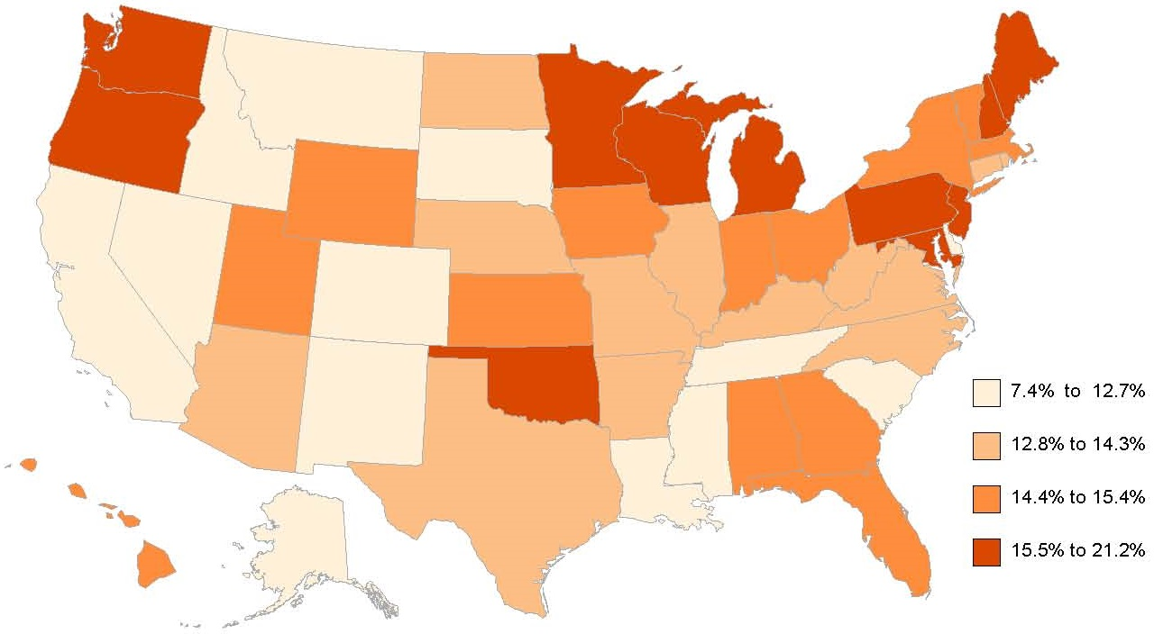
Obesity Percentages Gap Among People with and without Disabilities, by State, 2015
Data Source: Authors' calculations using data from the 2015 Behavioral Risk Factor Surveillance Survey BRFSS
44
Notes:
This slide shows that the gap in obesity percentages for states ranged from a high of 21.2% in the District of Columbia to a low of 7.4% in Mississippi. Only two states had a gap under 10 percentage points (Mississippi and Idaho), while 18 states had a gap of 15 points or more.

Slide 45
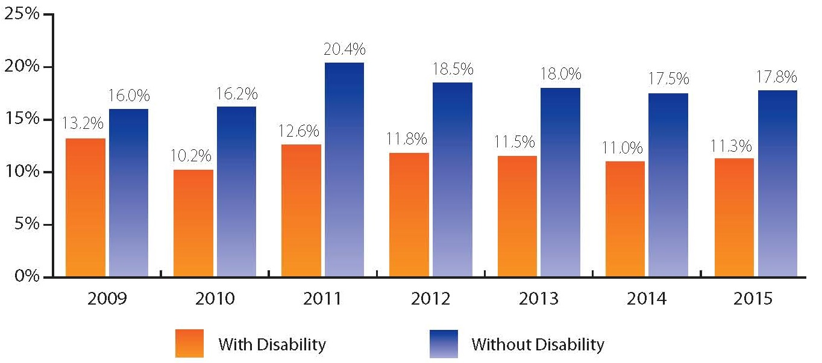
Binge Drinking Percentages, with and without Disabilities, 2009-2015
Data Source: Authors' calculations using data from the 2009-2015 Behavioral Risk Factor Surveillance Survey BRFSS
45
Notes:
In the years 2009 through 2015, the binge drinking percentage for people with disabilities varied from a low of 10.2% in 2010 to a high of 13.2% in 2009. For people without disabilities the percentages were higher, varying from 16.0% in 2009 to 20.4% in 2011. 2015 had increases of 0.3% for both people with and without disabilities.

Slide 46
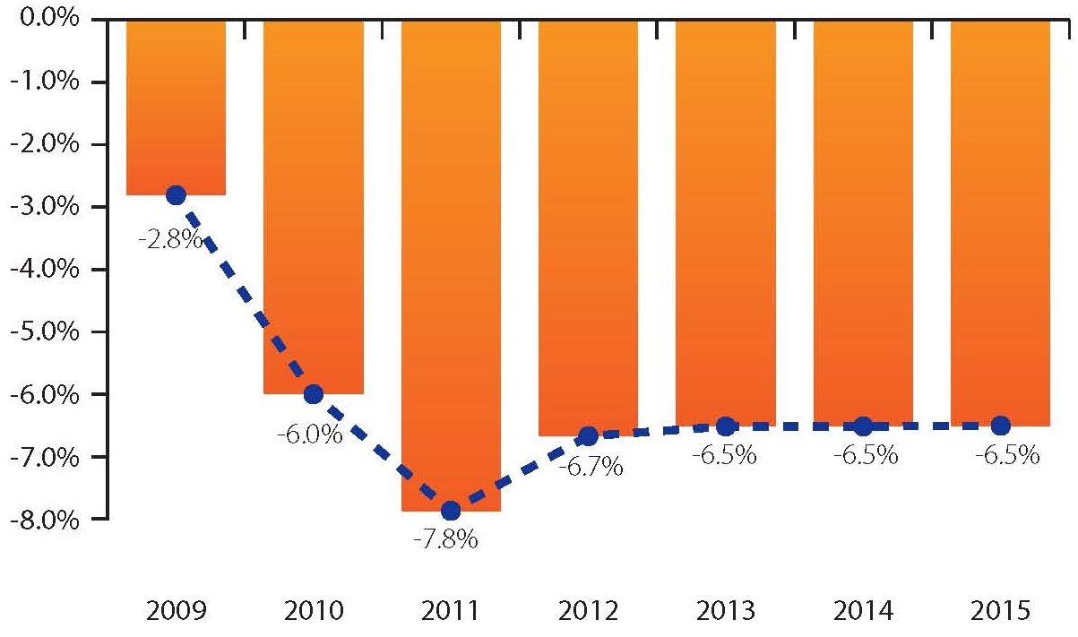
Binge Drinking Percentages Gap Among People with and without Disabilities, 2009-2015
Data Source: Authors' calculations using data from the 2009-2015 Behavioral Risk Factor Surveillance Survey BRFSS
46
Notes:
The binge drinking gap shows the degree to which people with disabilities have less binge drinking; the gap has been steady at 6.5 percentage points for three years now (from 2013 to 2015). The difference peaked at 7.8 percentage points in 2011, while the gap was lowest in 2009 at 2.8%.

Slide 47
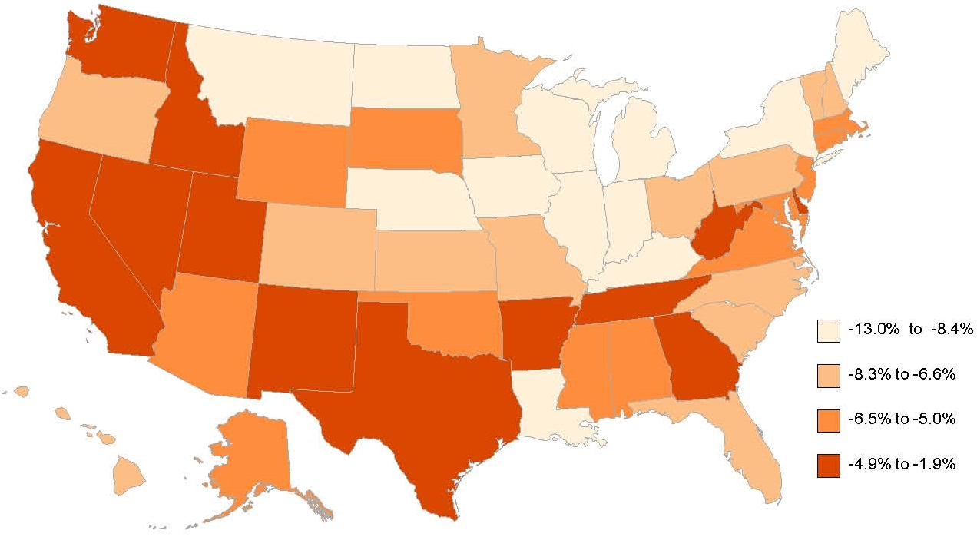
Binge Drinking Percentage Gap Among People with and without Disabilities, by State, 2015
Data Source: Authors' calculations using data from the 2015 Behavioral Risk Factor Surveillance Survey BRFSS
47
Notes:
This slide shows gaps in binge drinking for people with and without disabilities by state in 2015. Gaps in binge drinking for those ages 18 and over ranged from 13 points less (thus more people without disabilities binge drinking than those with disabilities) in North Dakota to 1.9 points less in Delaware. District of Columbia joined North Dakota as the only states with a gap in excess of 10 points. Fifteen states had a gap of less than 5 points.

