Slide 1
Release of the Annual Disability Statistics Collection
March 10, 2022 (and repeated live March 11, 2022

Slide 2

Welcome and Introduction
Andrew Houtenville

Slide 3



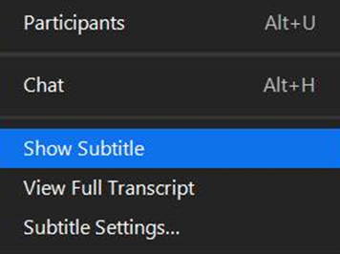
Some Zoom Tips
Tip #1: Sound
  Select the speakers you want to use for today’s webinar, click on the up arrow next to Audio Settings, and then select one of the options.
Tip #2: Close Captioning
  Click on Closed Caption, and then select Show Subtitle for subtitles, or select View Full Transcript to get a running transcript of the captions.
Your screen may look a bit different

Slide 4
ASL Interpretation
ASL Interpretation is available.
To see the gallery of speakers and the interpreter, we recommend joining from a computer rather than a phone or tablet.

Slide 5

Ask Questions
To ask a question, click on Q&A box, an enter your questins.
We will try to answer all questions, some during the presentations, and will stay on longer, if needed.

Slide 6
Fall Conference
Registration for our in-person and online event on October 6-7, 2022, is now open!
www.researchondisability.org/annual-event
Materials and satisfaction survey for this webcast are also available at this web site.

Slide 7
Acknowledgement
Annual Disability Statistics Collection is a product of the Rehabilitation Research and Training Center on Disability Statistics and Demographics (StatsRRTC).
Funding is from the National Institute on Disability, Independent Living, and Rehabilitation Research (NIDILRR), grant number 90RTGE0001.
The information developed by the StatsRRTC does not necessarily represent the policies of NIDILRR, and you should not assume endorsement by the Federal Government (Edgar, 75.620 (b)).

Slide 8

Annual Disability Statistics Compendium
Shreya Paul

Slide 9
Objectives
Background
Introduce the Compendium
Updates on the American Community Survey
New - Voting and Registration section
How to access the Compendium and the technical assistance

Slide 10
Background
In the U.S. disability statistics are often difficult to find or scattered across multiple sources.
The Compendium and the Supplement aim to compile all these statistics in one place.
The goal is to bridge the gap between producers and consumers of disability statistics.
Notes:
Disability statistics are often difficult to find and if available they are often scattered across multiple sources. Through the compendium and the supplement, we aim to provide a comprehensive compilation of disability statistics all in one place. Our number one goal is to bridge the gap between producers and consumers of disability statistics and to do so in an accessible and timely fashion.

Slide 11
Current
Products
The Annual Disability Statistics Compendium
The Annual Disability Statistics Supplement
The Annual Report on People with Disabilities in America
Two Infographics
Experience of People with Disabilities in Rural America
Social Inequities Experienced by African Americans

Slide 12
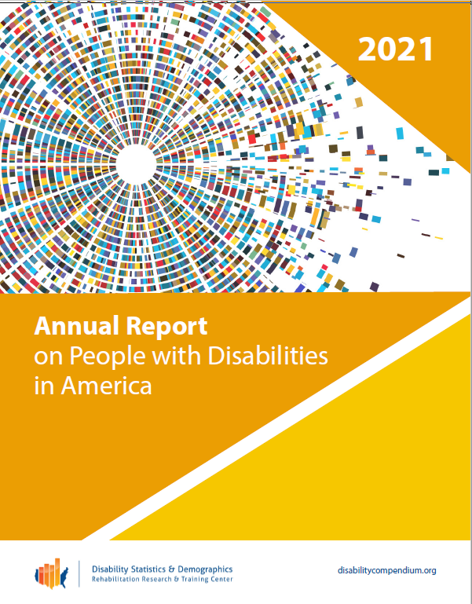
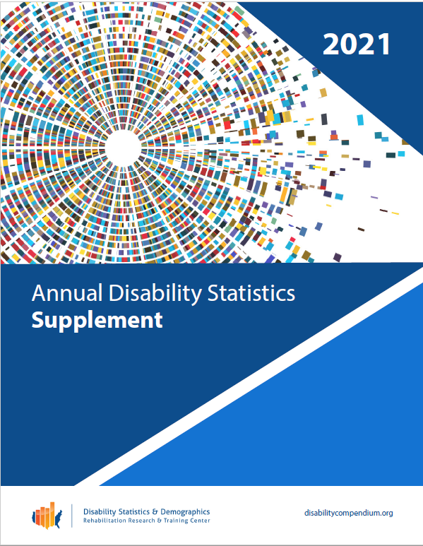
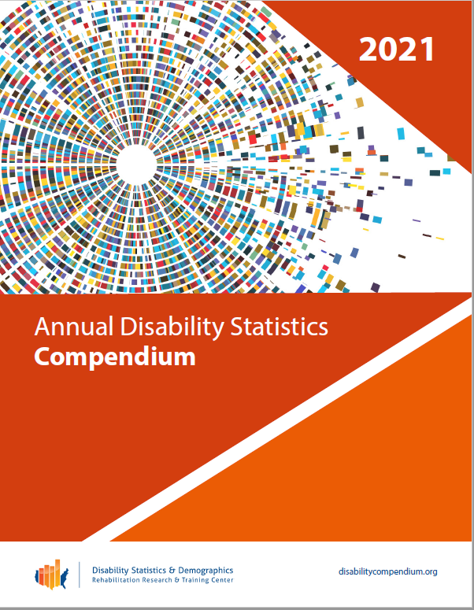
The Design
Notes:
Comprehensive, accessible, reliable and timely.
This is how our products look this year. Our team works very hard to make these comprehensive, accessible, reliable and timely. Most of our products are available in both HTML and accessible PDF format.

Slide 13
Data Sources
American Community Survey Public Use Microdata Sample (ACS PUMS) with experimental weights
Behavioral Risk Factor Surveillance System (BRFSS)
Social Security Administration (SSA)
Veterans Benefits Administration (VBA)
Rehabilitation Services Administration (RSA)
Current Population Survey (CPS)

Slide 14
Impact of COVID-19 on the American Community Survey (ACS)
Due to the Covid-19 pandemic, data collection activities were interrupted.
In-person interviewing ceased; only internet and telephone interviewing continued.
U.S. Census Bureau examined data quality issues associated with non-response and lower sample sizes.
In response, U.S. Census Bureau-issued experimental weights.

Slide 15
Topics Covered
Population Size, Prevalence, and Disability Type
Demographic Characteristics
Health, Health Insurance, Risky Behavior
Employment, Earnings, and Poverty
Social Security Disability Insurance (SSDI) and Supplemental Security Income (SSI)
Special Education Services and Outcomes
Voting and Registration and more

Slide 16
New this Year
Voting and Registration Section
Provides voting and registration statistics from the 2020 US presidential elections.
Co-sponsored by the Rutgers University, Program on Disability Research.
Adapted from the “Fact Sheet: Disability and Voter Turnout in the 2020 Elections,” by Lisa Schur and Douglas Kruse.
Uses the Current Population Survey.

Slide 17
Using the Compendium

Slide 18
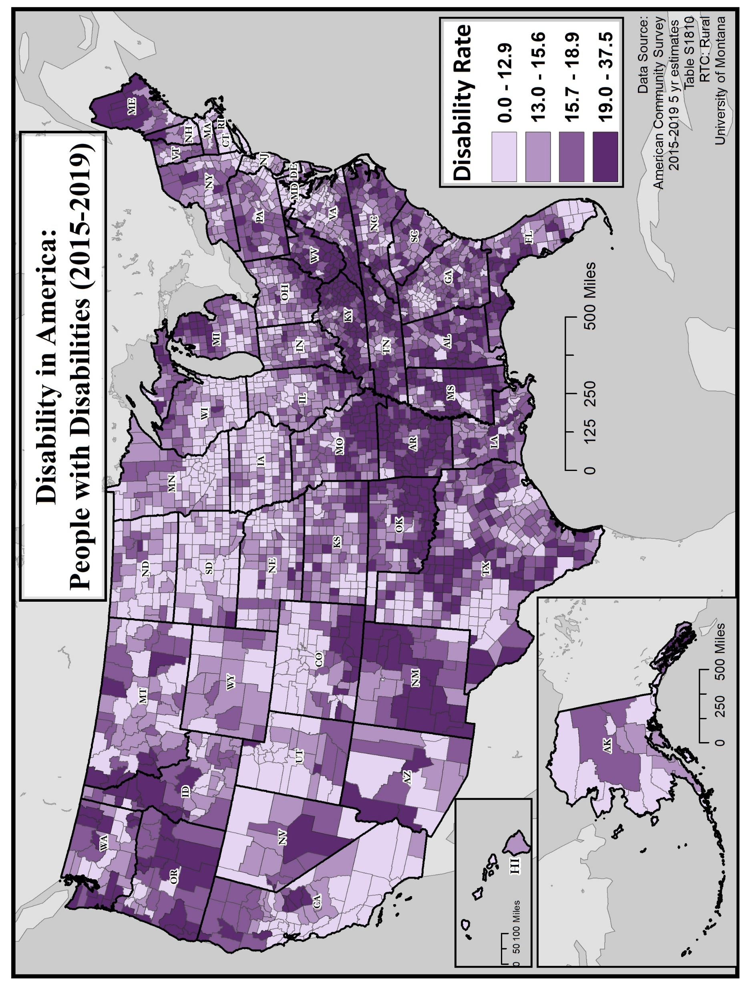
Key Findings

Slide 19
Employment Rate of People with Disabilities, 2020

Slide 20
Employment Rate of People with Disabilities, 2020

Slide 21
Employment Rate of People with Disabilities, 2020
Hearing Vision Cognitive Ambulatory Independent Living Self-care

Slide 22
Ongoing Efforts
The Status of Veterans with Disabilities in the United States Infographic
Standard errors files
Make the reports and the website more accessible and user-friendly

Slide 23
Contact Information
Shreya Paul
Shreya.Paul@unh.edu
Institute on Disability
University of New Hampshire
10 West Edge Drive, Suite 101
Durham, NH 03824
Website: www.disabilitycompendium.org
Technical Assistance: disability.statistics@unh.edu
866-538-9521

Slide 24
Thank You

Slide 25
Annual Report on
People with Disabilities in America
Andrew Houtenville

Slide 26
Background
Key Indicators: Informed by the National Council on Disability (NCD) report from 2008, calling for monitoring the status of people with disabilities.
Time Trends: Each year, looking to “make a call” each year on whether we observe statistically significance improvement.
Data Source: American Community Survey Public Use Microdata Sample (ACS PUMS).
Notes:
Disability statistics are often difficult to find and if available they are often scattered across multiple sources. Through the compendium and the supplement, we aim to provide a comprehensive compilation of disability statistics all in one place. Our number one goal is to bridge the gap between producers and consumers of disability statistics and to do so in an accessible and timely fashion.

Slide 27
Key
Indicators
Range of 12 indicators
Related to population size, education, employment, earnings from work, health insurance, housing, transportation, and a proxy for accessibility.
Next year … looking to add health and healthcare access (using health surveys).

Slide 28
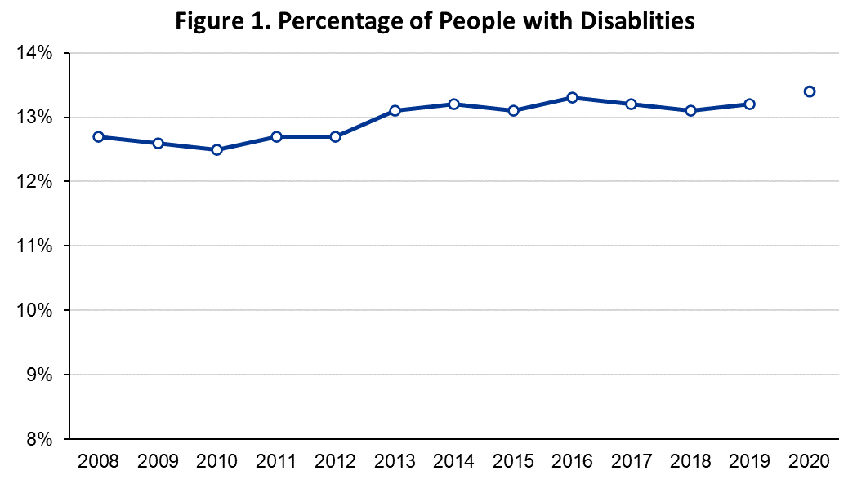
14.3%

Slide 29
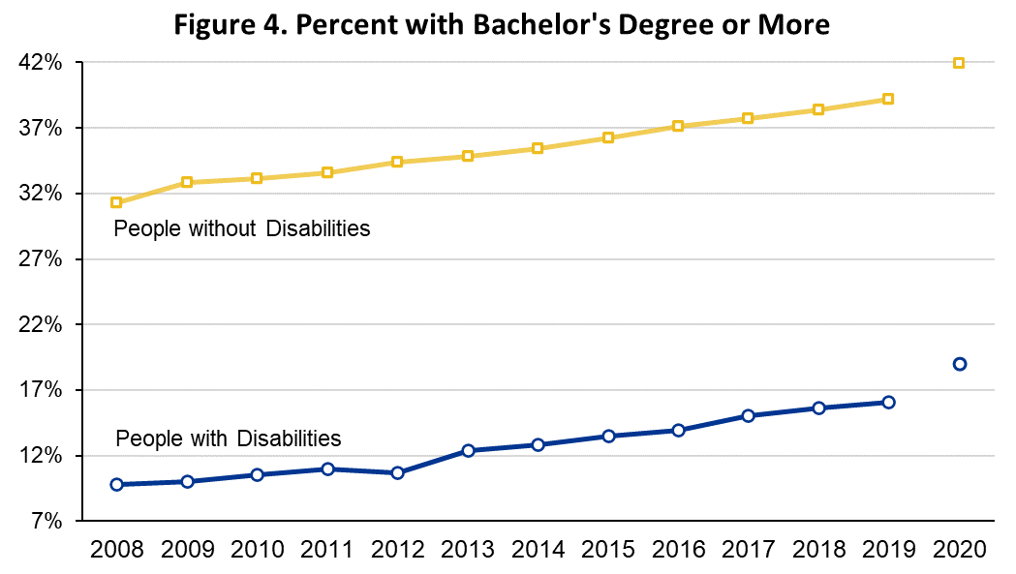
41.9%
Gap = -22.9%pts
19.9%

Slide 30
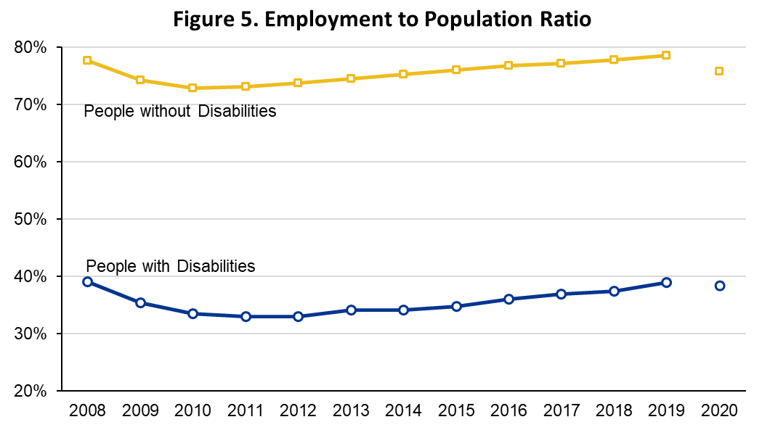
75.8%
Gap = -37.4%pts
38.4%

Slide 31
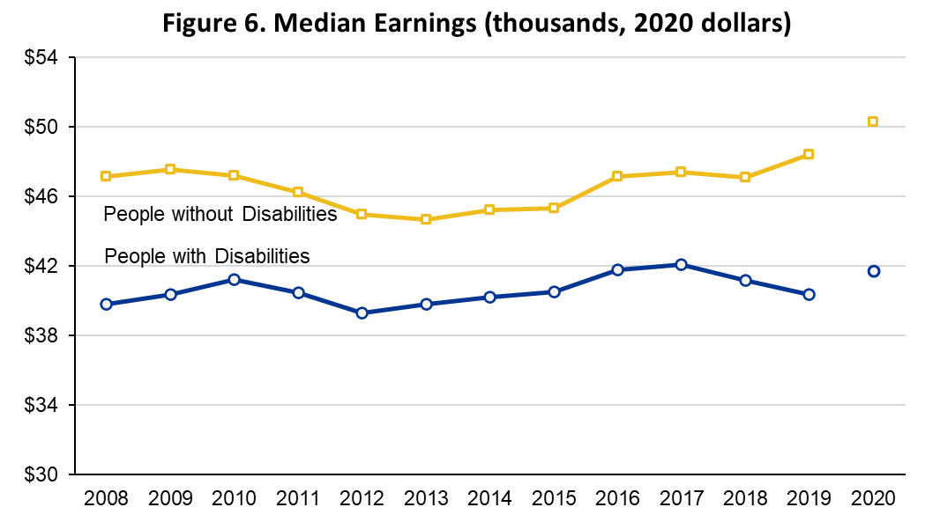
$50,3K
Gap = -$8.6K
$41.7K

Slide 32
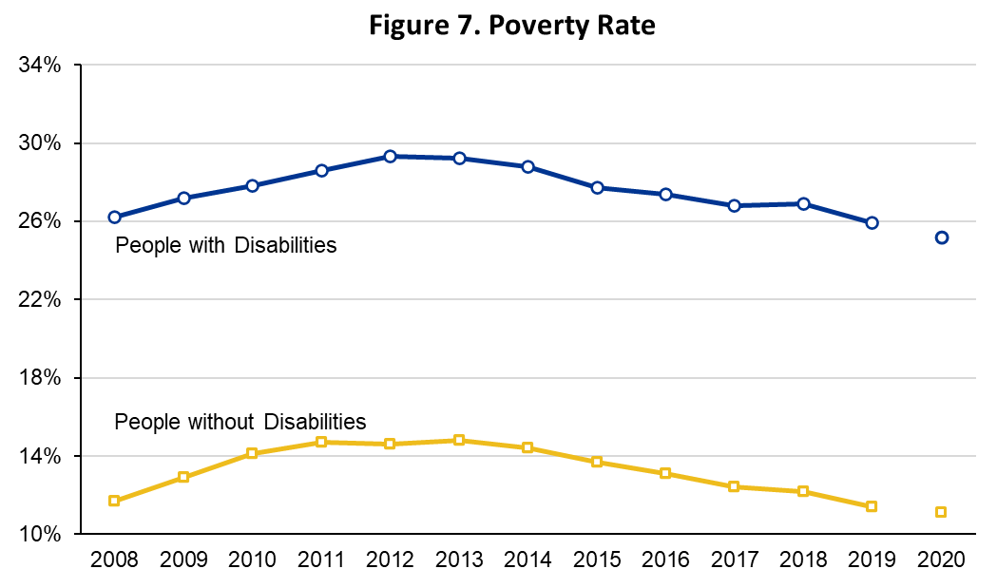
25.2%
Gap = +14.1%pts
11.1%

Slide 33
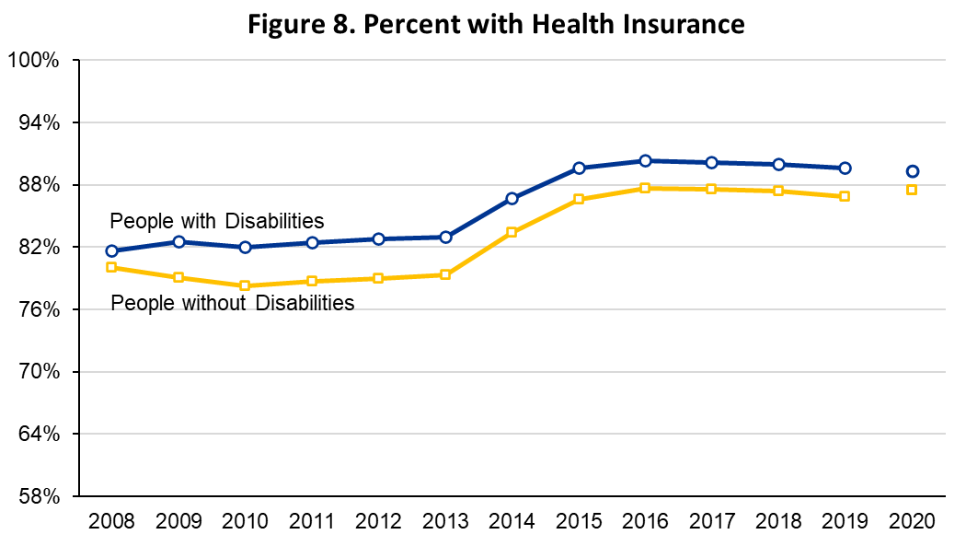
Gap = +1.9%pts
89.3%
87.5%

Slide 34
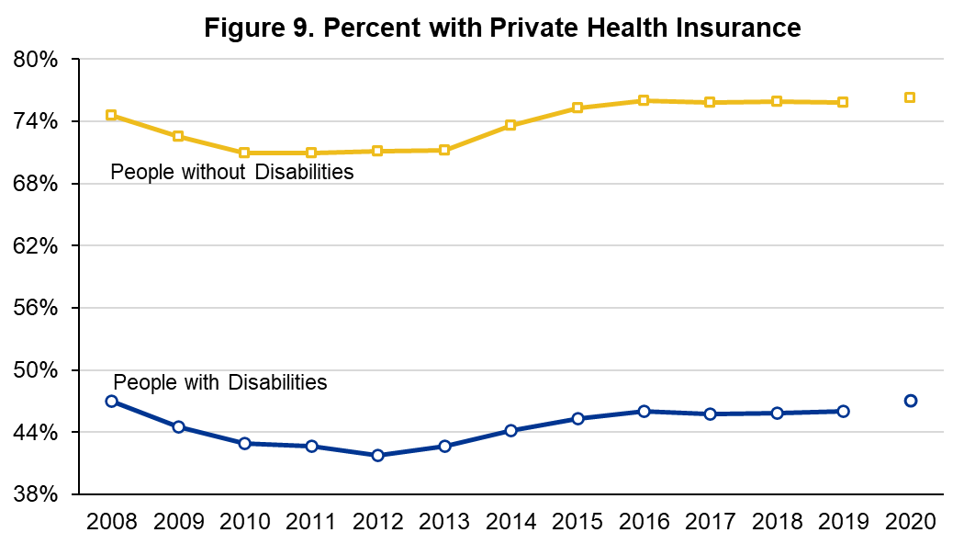
76.3%
76.3%
Gap = -37.4%pts
Gap = -29.2%pts
47.1%
47.1%

Slide 35
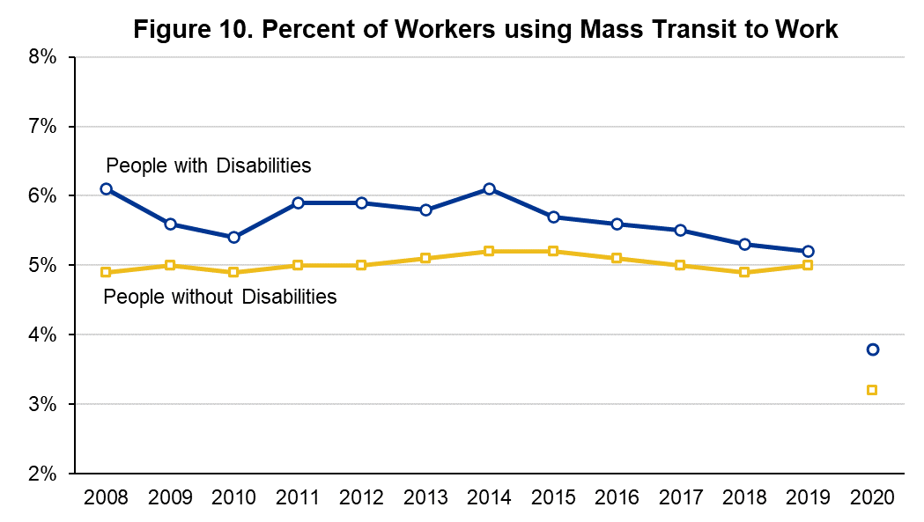
3.8%
3.2%
Gap = +0.6%pts

Slide 36
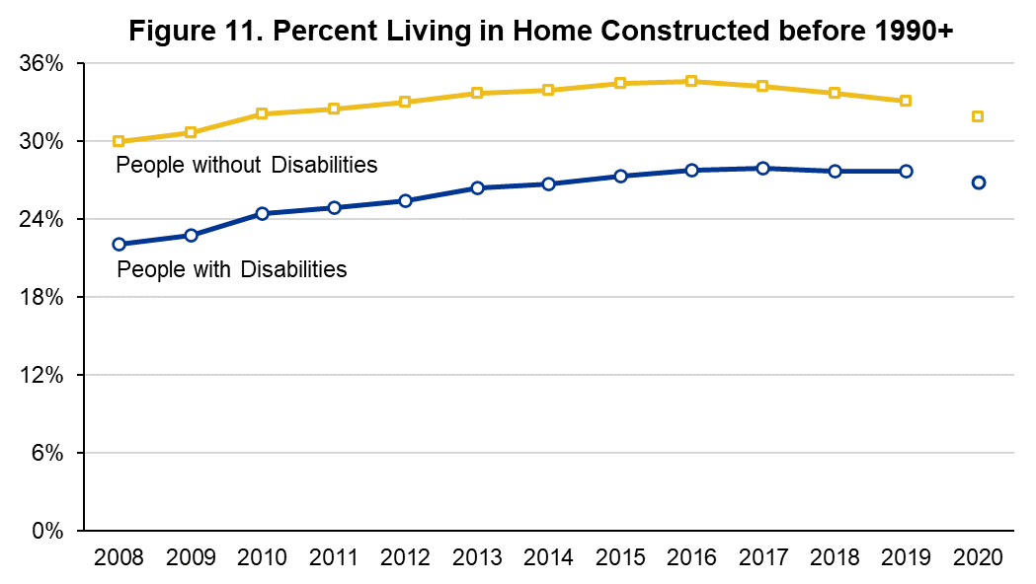
31.9%
26.9%
Gap = -5.0%pts

Slide 37
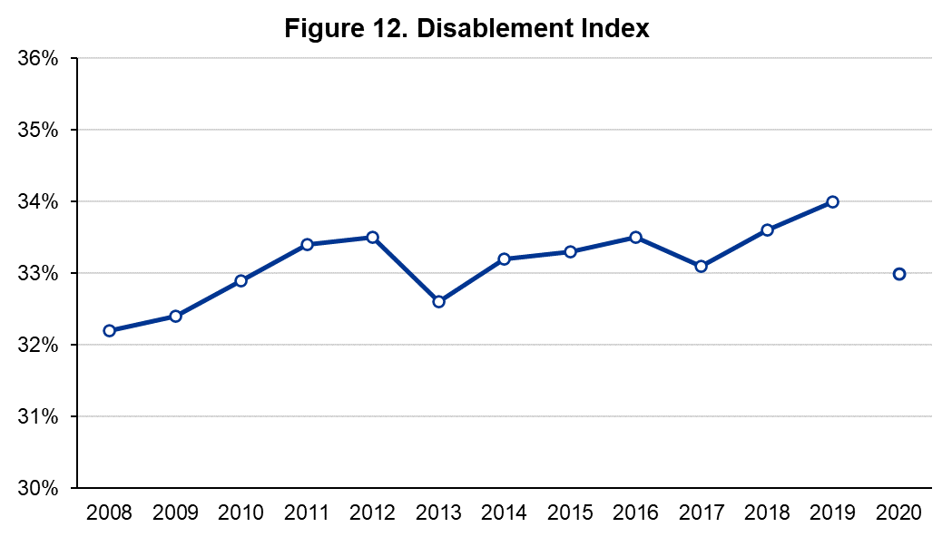
33.3%

Slide 38
Thank You

Slide 39


Infographics – African Americans and Rural Populations
Megan Henly Sawyer Rogers
Notes:
MEGAN INTRODUCTION
Hello I am Sawyer Rogers, a Disability Research Assistant at the Institute on Disability. I am a white man in an office with a white button down and purple tie.

Slide 40
Background on Infographics
1-page overview with visual summary
Explores the intersection of disability and other identities
Created in partnership with subject experts
New subject areas added each year
Notes:
Infographics are the latest addition to our compendium collection.
In 2021 we began this series by introducing an infographic on rural areas, which my colleague Sawyer Rogers will describe in a moment. This year we added a new infographic on the African American population with disability, which I’d like to highlight briefly.
This infographic was curated in collaboration with Langston University’s RRTC on Research and Capacity Building for Minority Entities. Langston’s RRTC is focused on examining experiences and outcomes of people with disabilities from traditionally underserved racial and ethnic communities and our RRTC is tasked with bridging the divide between the producers and end users of disability statistics. So this partnership resulted in this one-page infographic which provides some basic background on the educational, employment, and social characteristic of the African American population with disabilities, because having these statistics handy can help to illustrate the ways in which social inequities are perpetuated for this population and to help policymakers consider how policies could be used to promote equity in these areas.
These are 1-page summaries focused on a single topic or population. We highlight some of the most recent disability statistics in an easy-to-read format with a visual representation of the findings. This is useful
for displaying;
for disseminating to people who maybe don’t want to pour through all of the detailed numbers, but want an overview;
for people who want help with interpretation or need a visual representation.
These infographics are centered on a single topic or population, allowing us to explore the intersection of disability and other identities and these are created in partnership with subject area experts around the country. Our plan has been to update the infographics each year so that the most recent numbers are available at the time of this Compendium event. In addition, we plan to add to our collection, adding an additional Infographic on a new subject area each year.

Slide 41
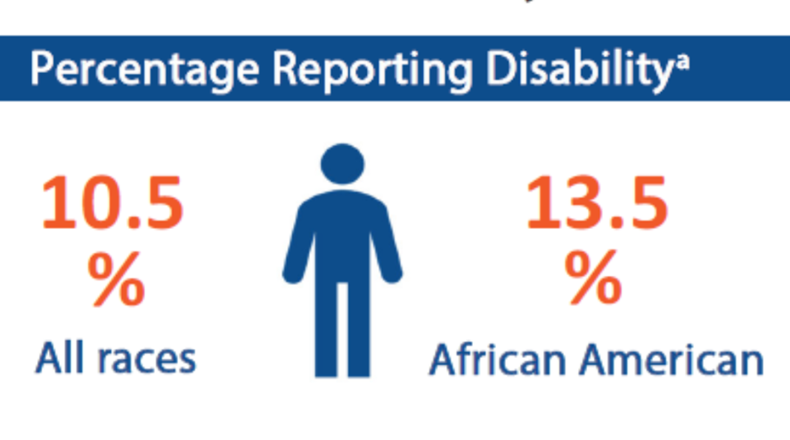
African-Americans with Disabilities
Notes:
I’ll highlight a few of the images shown on this infographic, starting with an overview on the percentage reporting a disability – among those of all ages, disability prevalence is 10.5% for the overall population, but slightly higher for the African American population at 13.5%.

Slide 42
Educational inequalities
Notes:
With respect to education, we note that among the population of students aged 6 to 21 with a disability, African American students are 15.4% more likely to spend time outside a regular classroom and 160% more likely to be placed in a correctional facility. Down the line, we note lower high school completion rates for African Americans with disabilities among the working-age population.

Slide 43
Other social inequalities
Notes:
There are other inequalities, most notably, African Americans with disabilities are 20% less likely to be employed, 33% more likely to experience poverty, and 49% more likely to lack adequate housing than the general population with a disability. More detail on these measures are available for other racial and ethnic groups in our Disability Compendium and Supplement.
Now I’d like to turn it over to Sawyer Rogers to talk about our other infographics.

Slide 44
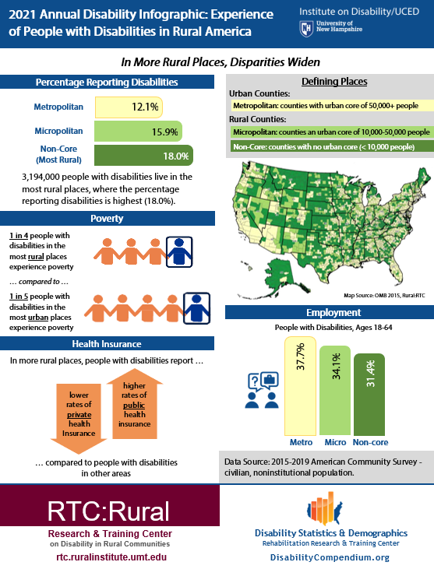
Updated Numbers 2014-2019 ACS 5-year data
“In More Rural Places, Disparities Widen”
Notes:
Here is the rural infographic with updated numbers for 2014 to 2019 American Community Survey (ACS) 5 year data.
The rural infographic is made in collaboration with RTC:Rural a research and training center on disability in rural communities at the University of Montana.
Before we get into the specific data within the infographic, let us start with some important definitions with this infographic:
Urban counties, are referred to as metropolitan. Metropolitan is defined as counties with an urban core of 50,000 or more people.
While rural counties are referred to as micropolitan or non core. Micropolitan are counties with an urban core of 10,000 to 50,000 people. While non core are counties with no urban core (meaing less than 10,000 people).
The major takeaway from this infographic is that in more rural places disparities widen.

Slide 45
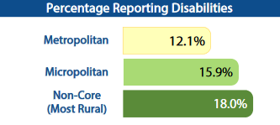
Prevalence
Notes:
With disability prevalence, the infographic reveals that disability prevalence goes up the more rural the place. In metropolitan counties 12.1% reported disabilities, while micropolitan reported 15.9%, and Non-core reported 18%.

Slide 46
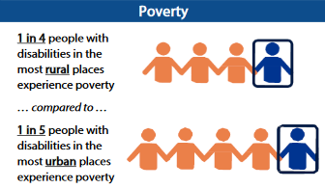
Poverty Rate
Notes:
With poverty rate the infographic displays that 1 in 4 people with disabilities in the most rural places experience poverty compared to 1 in 5 people with disabilities in the most urban places.

Slide 47
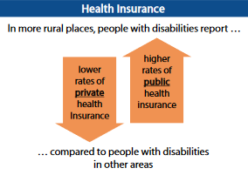
Health Insurance
Notes:
With health insurance, the infographic portrays how in more rural places, people with disability report lower rates of private health insurance and higher rates of public health insurance compared to people with disabilities in other areas.

Slide 48
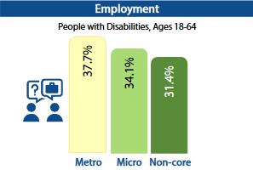
Employment
Notes:
And finally with employment, the infographic displays that the more rural the place the lesser the employment rate for people with disabilities aged 18 to 64. Metropolitain has a 37.7% employment rate, while micropolitan has 34.1%, and Non-core 31.4%.

Slide 49
More detail available
See our full reports for:
Data on other racial and ethnic groups
Other education statistics
Other employment statistics
Other housing statistics
Find it all at disabilitycompendium.org
Notes:
If you are interested in more statistics or the data that creates these graphics, please see the other parts of our collection. The Disability Statistics Compendium, the Supplement, the Annual Report, and the County Reports all contain data relating to racial and ethnic groups, education, employment, and housing. These are available on our website disabilitycompendium.org.

Slide 50
Thank You
Infographics made in collaboration with
Langston University RRTC
and
University of Montana RTC:Rural
Please reach out with any questions!
disability.statistics@unh.edu
Notes:
Thank you to Langston University RRTC and the University of Montana RTC: Rural for their collaboration with these infographics. And if you have any questions about the infographics, please feel free to reach out to disability.statistics@unh.edu.
Now I will turn it back over to Andrew for questions.

Slide 51
Questions?
Check out our website!
www.researchondisability.org/annual-event
Materials for this webinar
Satisfaction survey
New! Registration for our in-person and online event on October 6-7, 2022, is now open!

Slide 52
Thank you!
Get in touch:
Andrew.Houtenville@unh.edu
Shreya.Paul@unh.edu
Megan.Henly@unh.edu
Sawyer.Rogers@unh.edu

